Slide 1
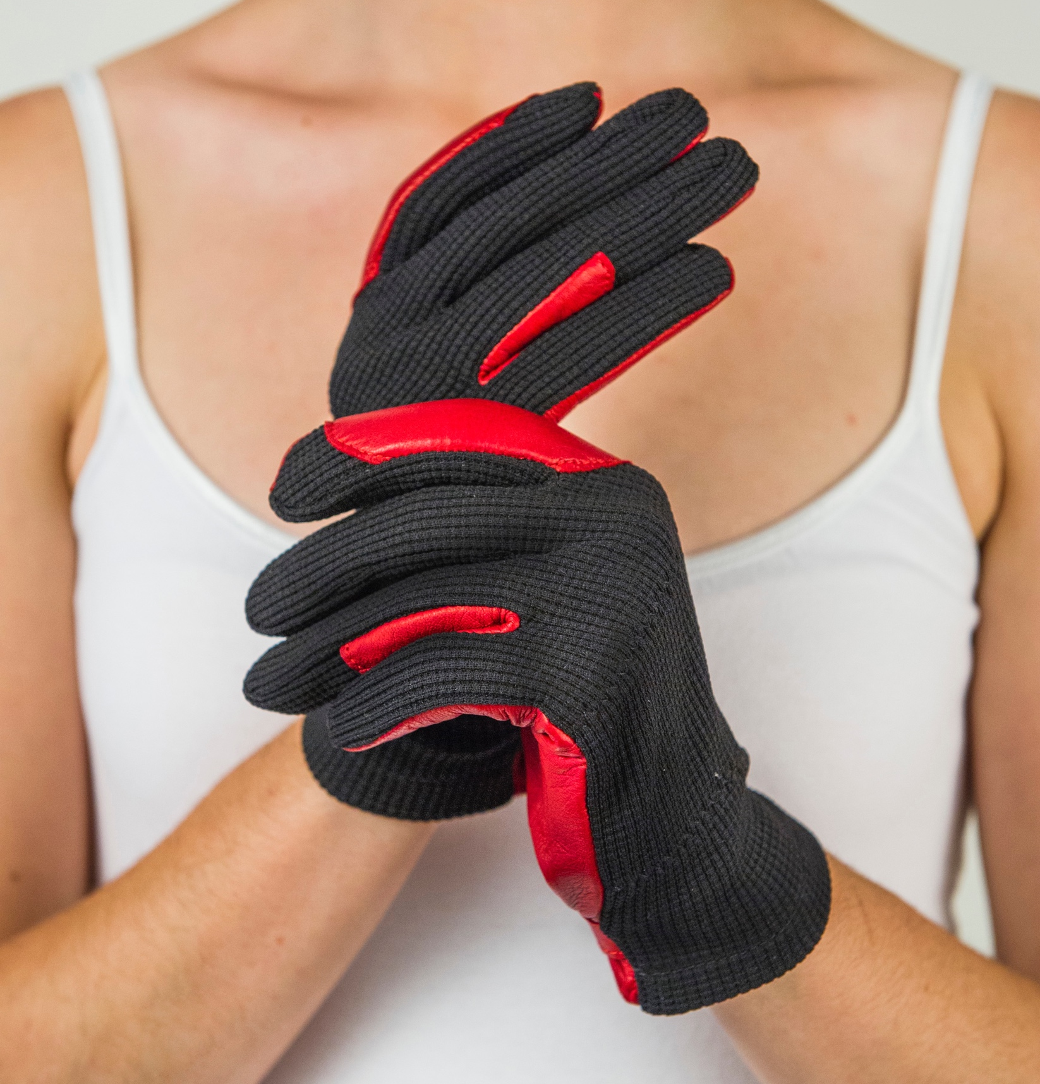
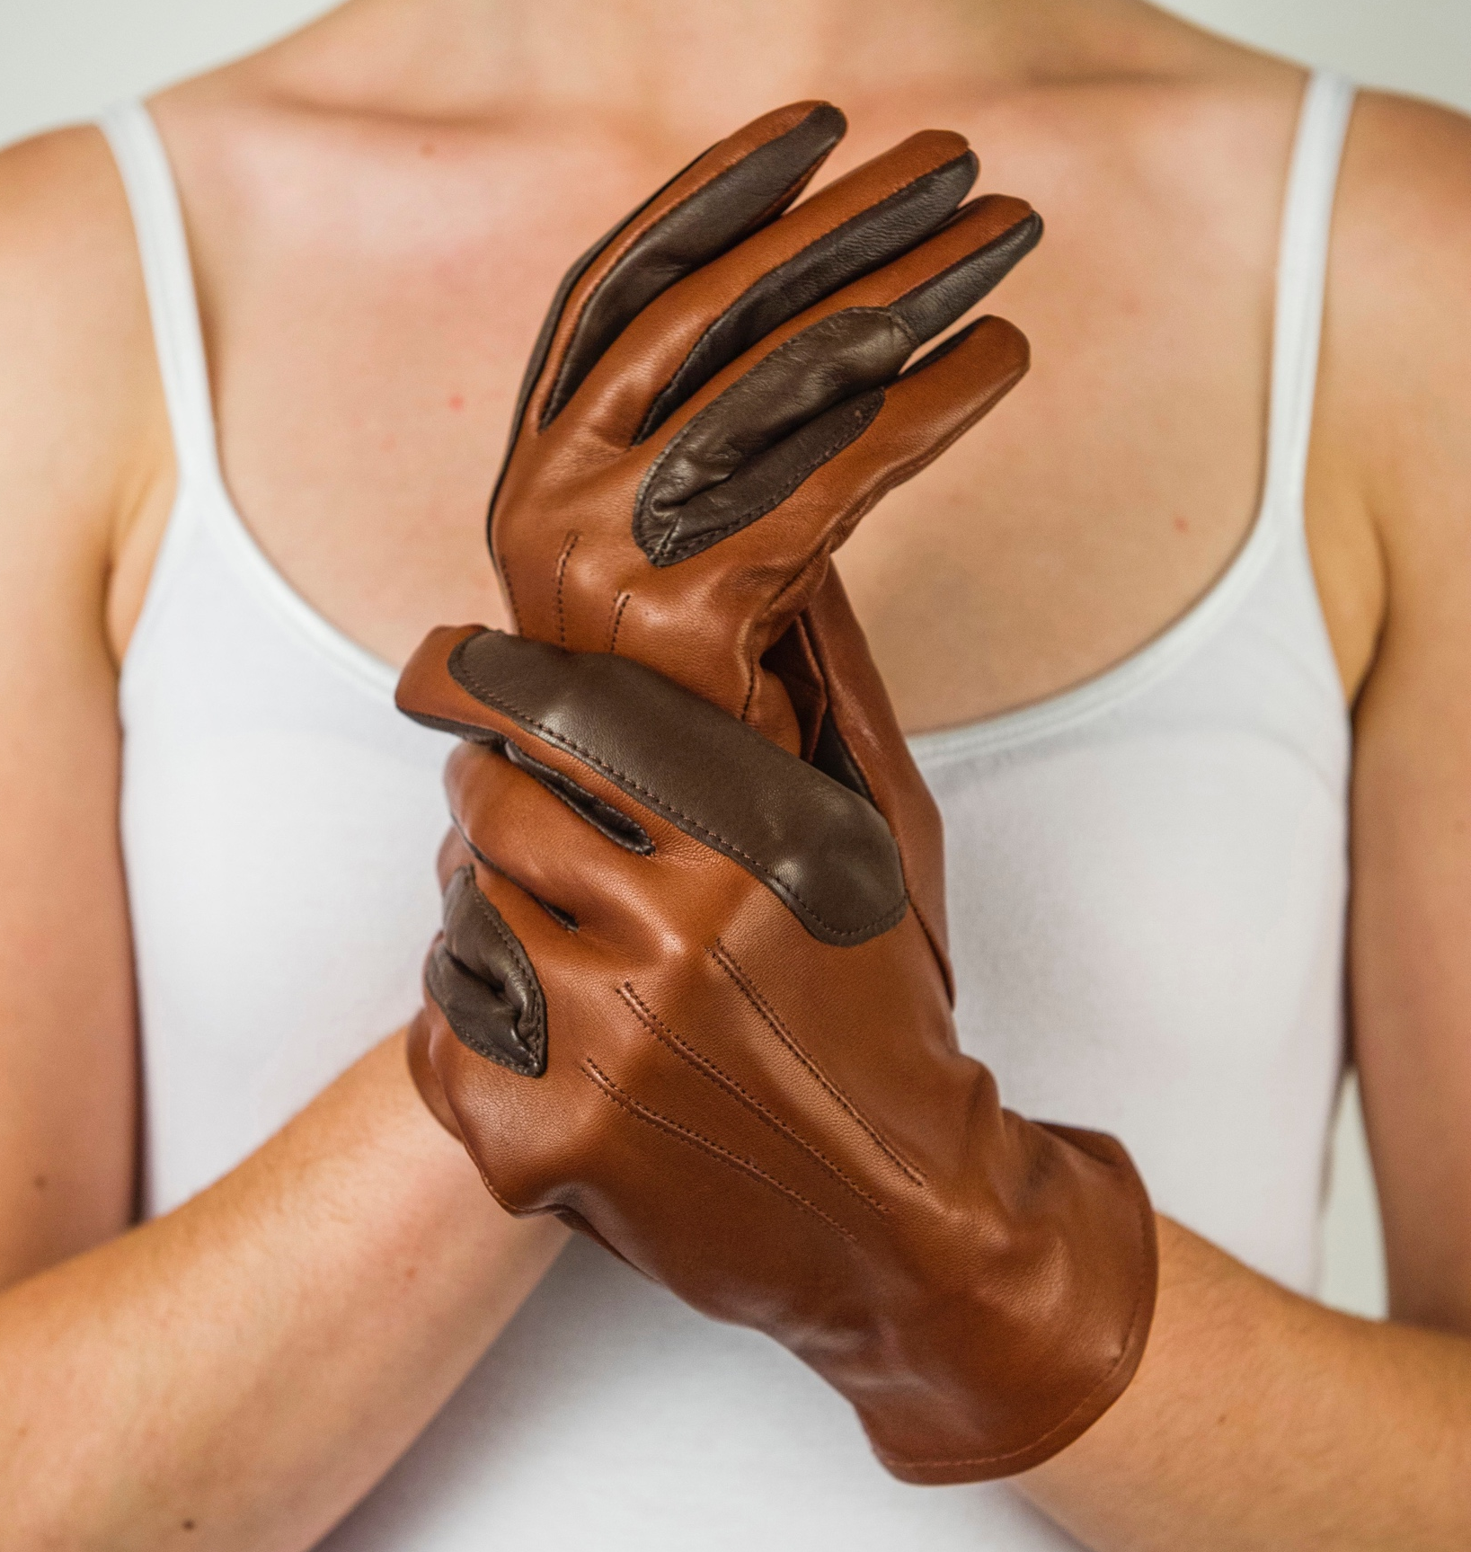
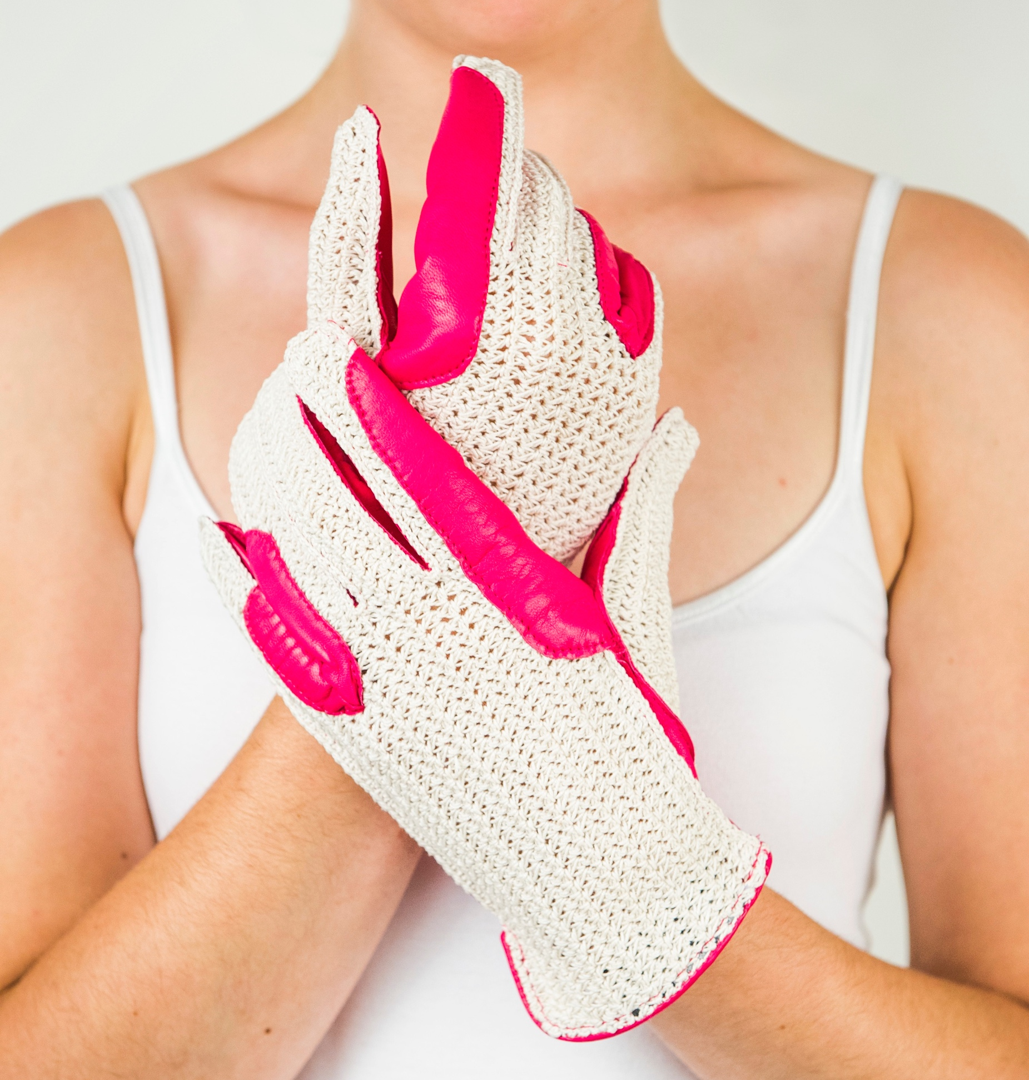
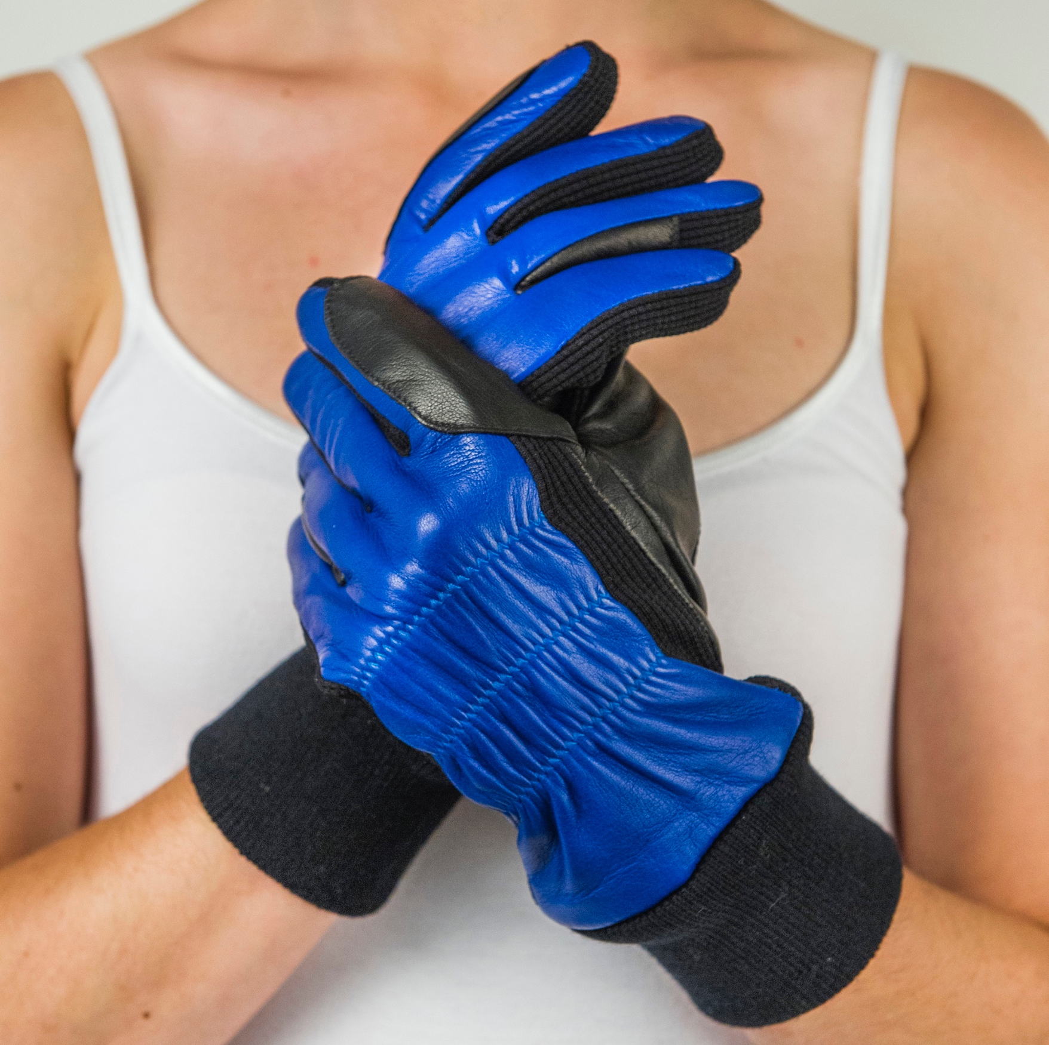
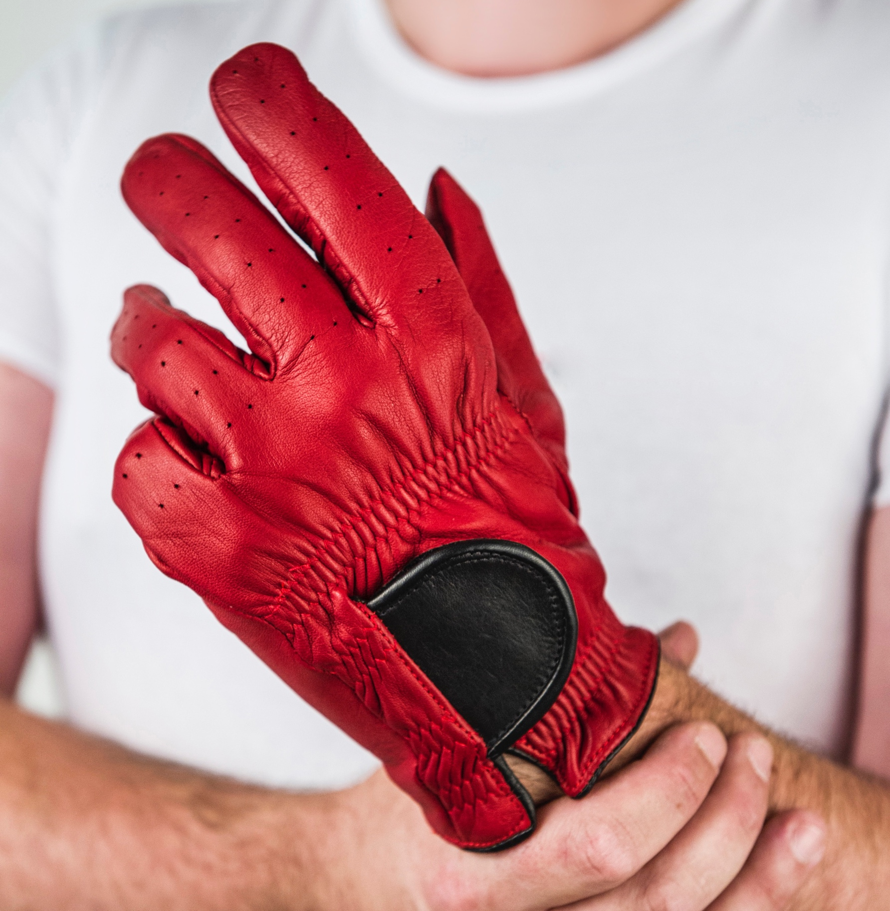
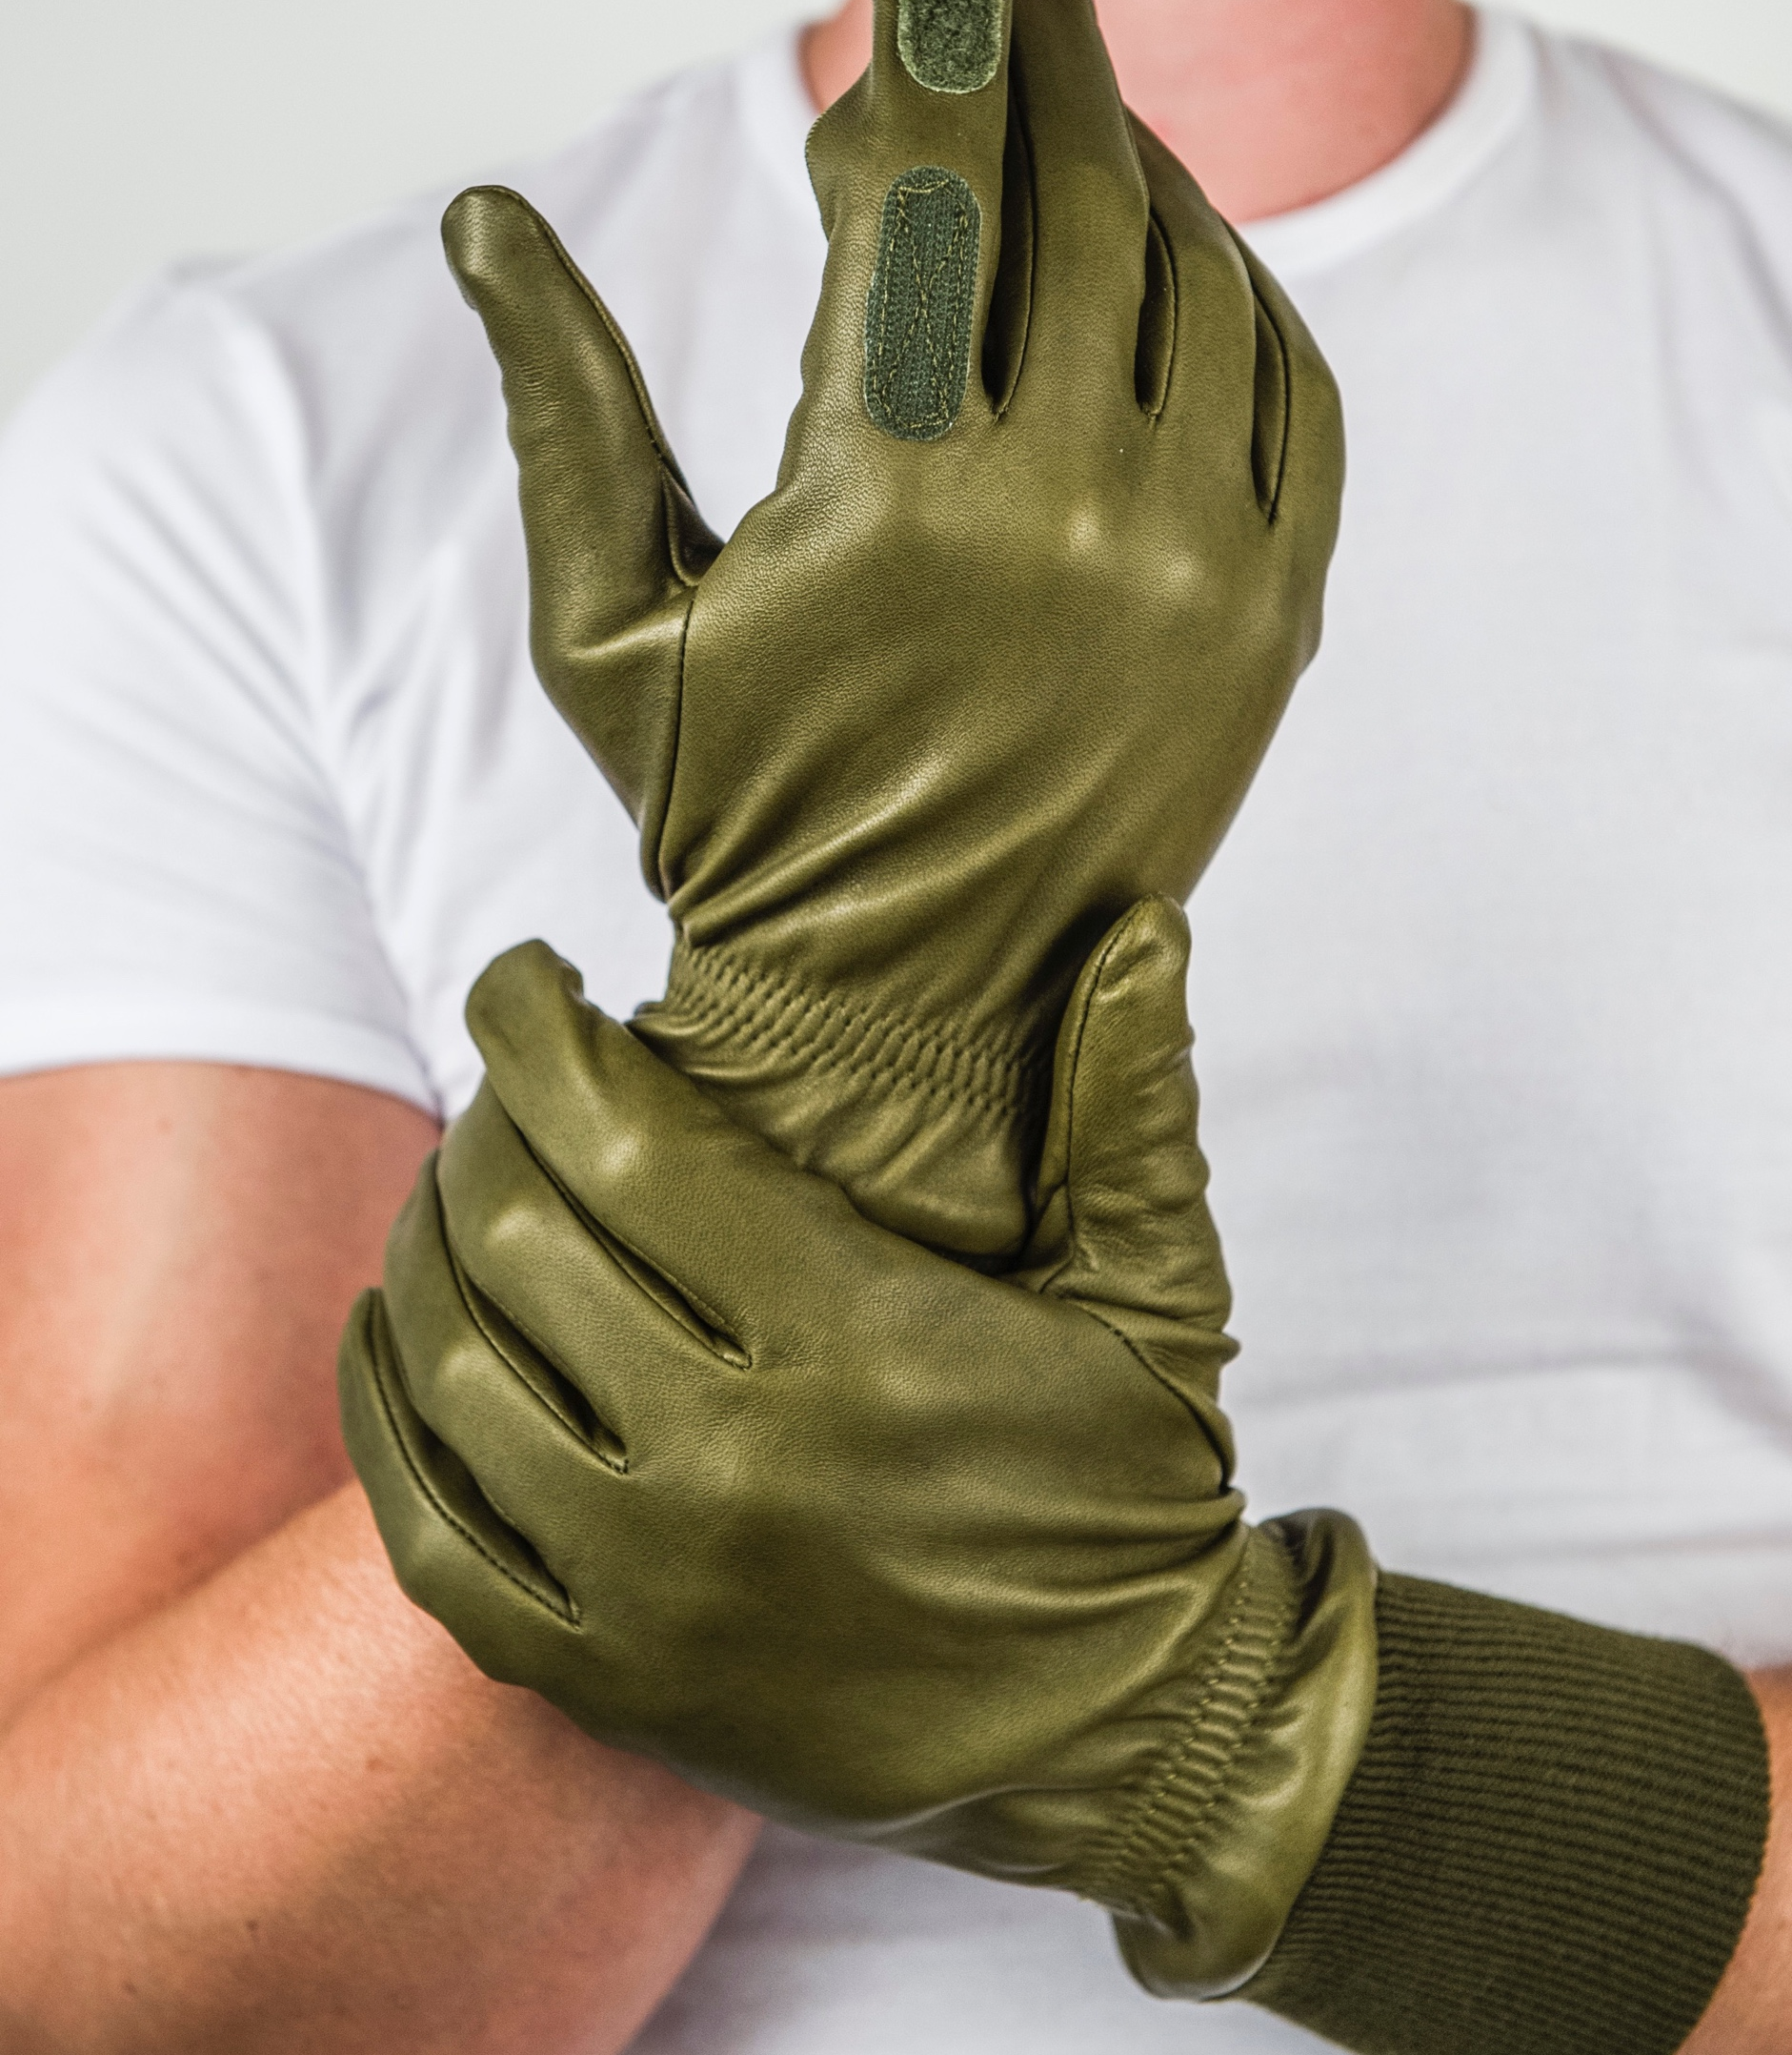
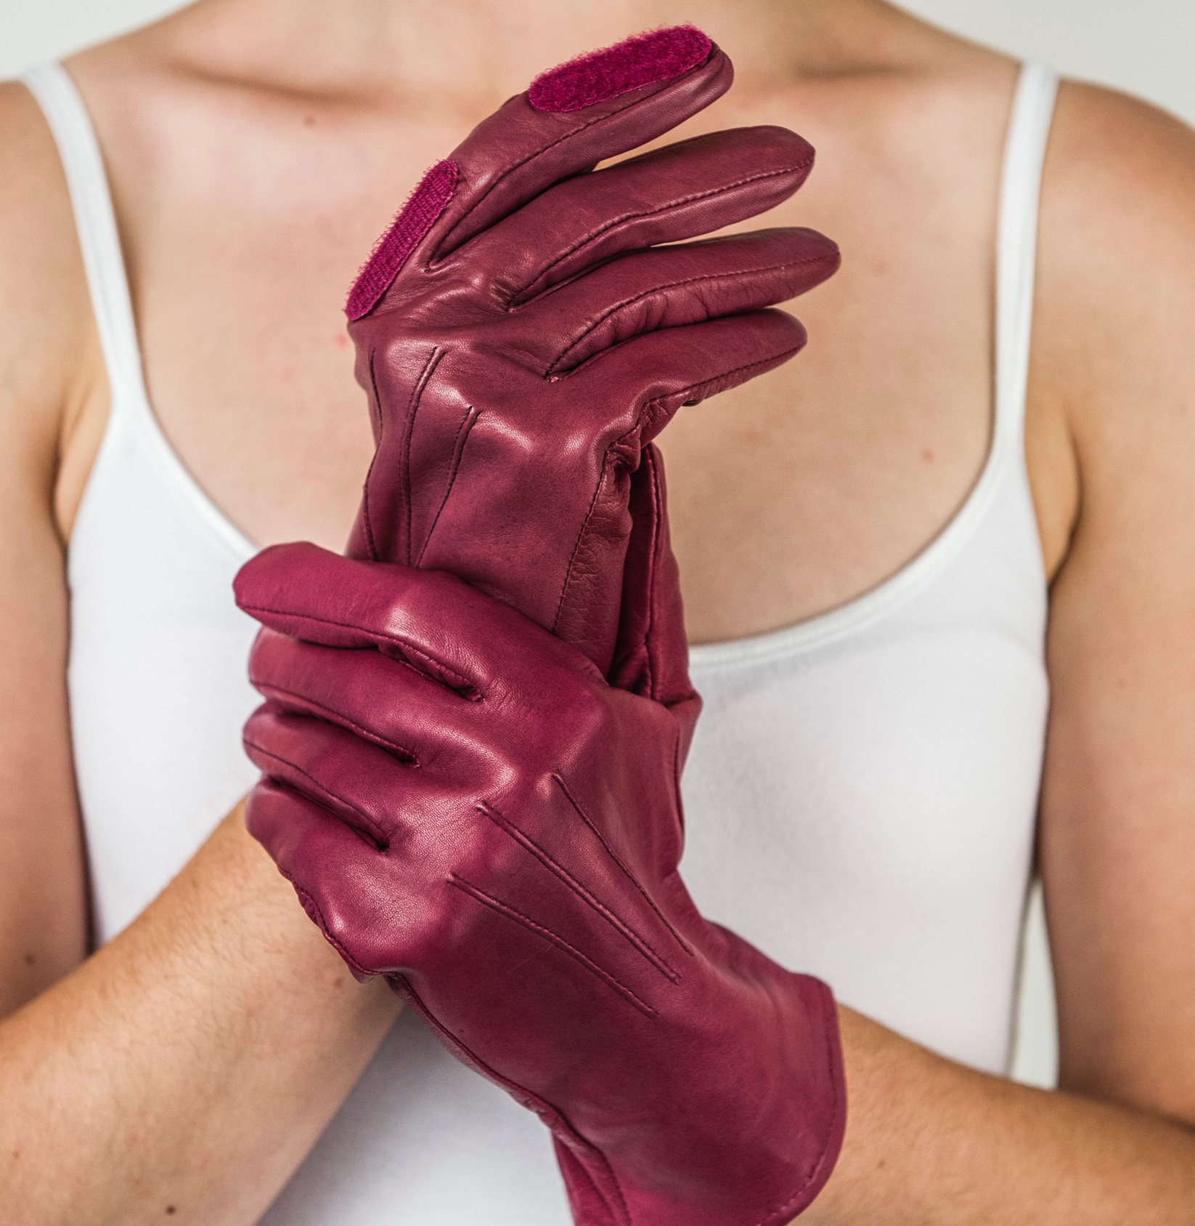
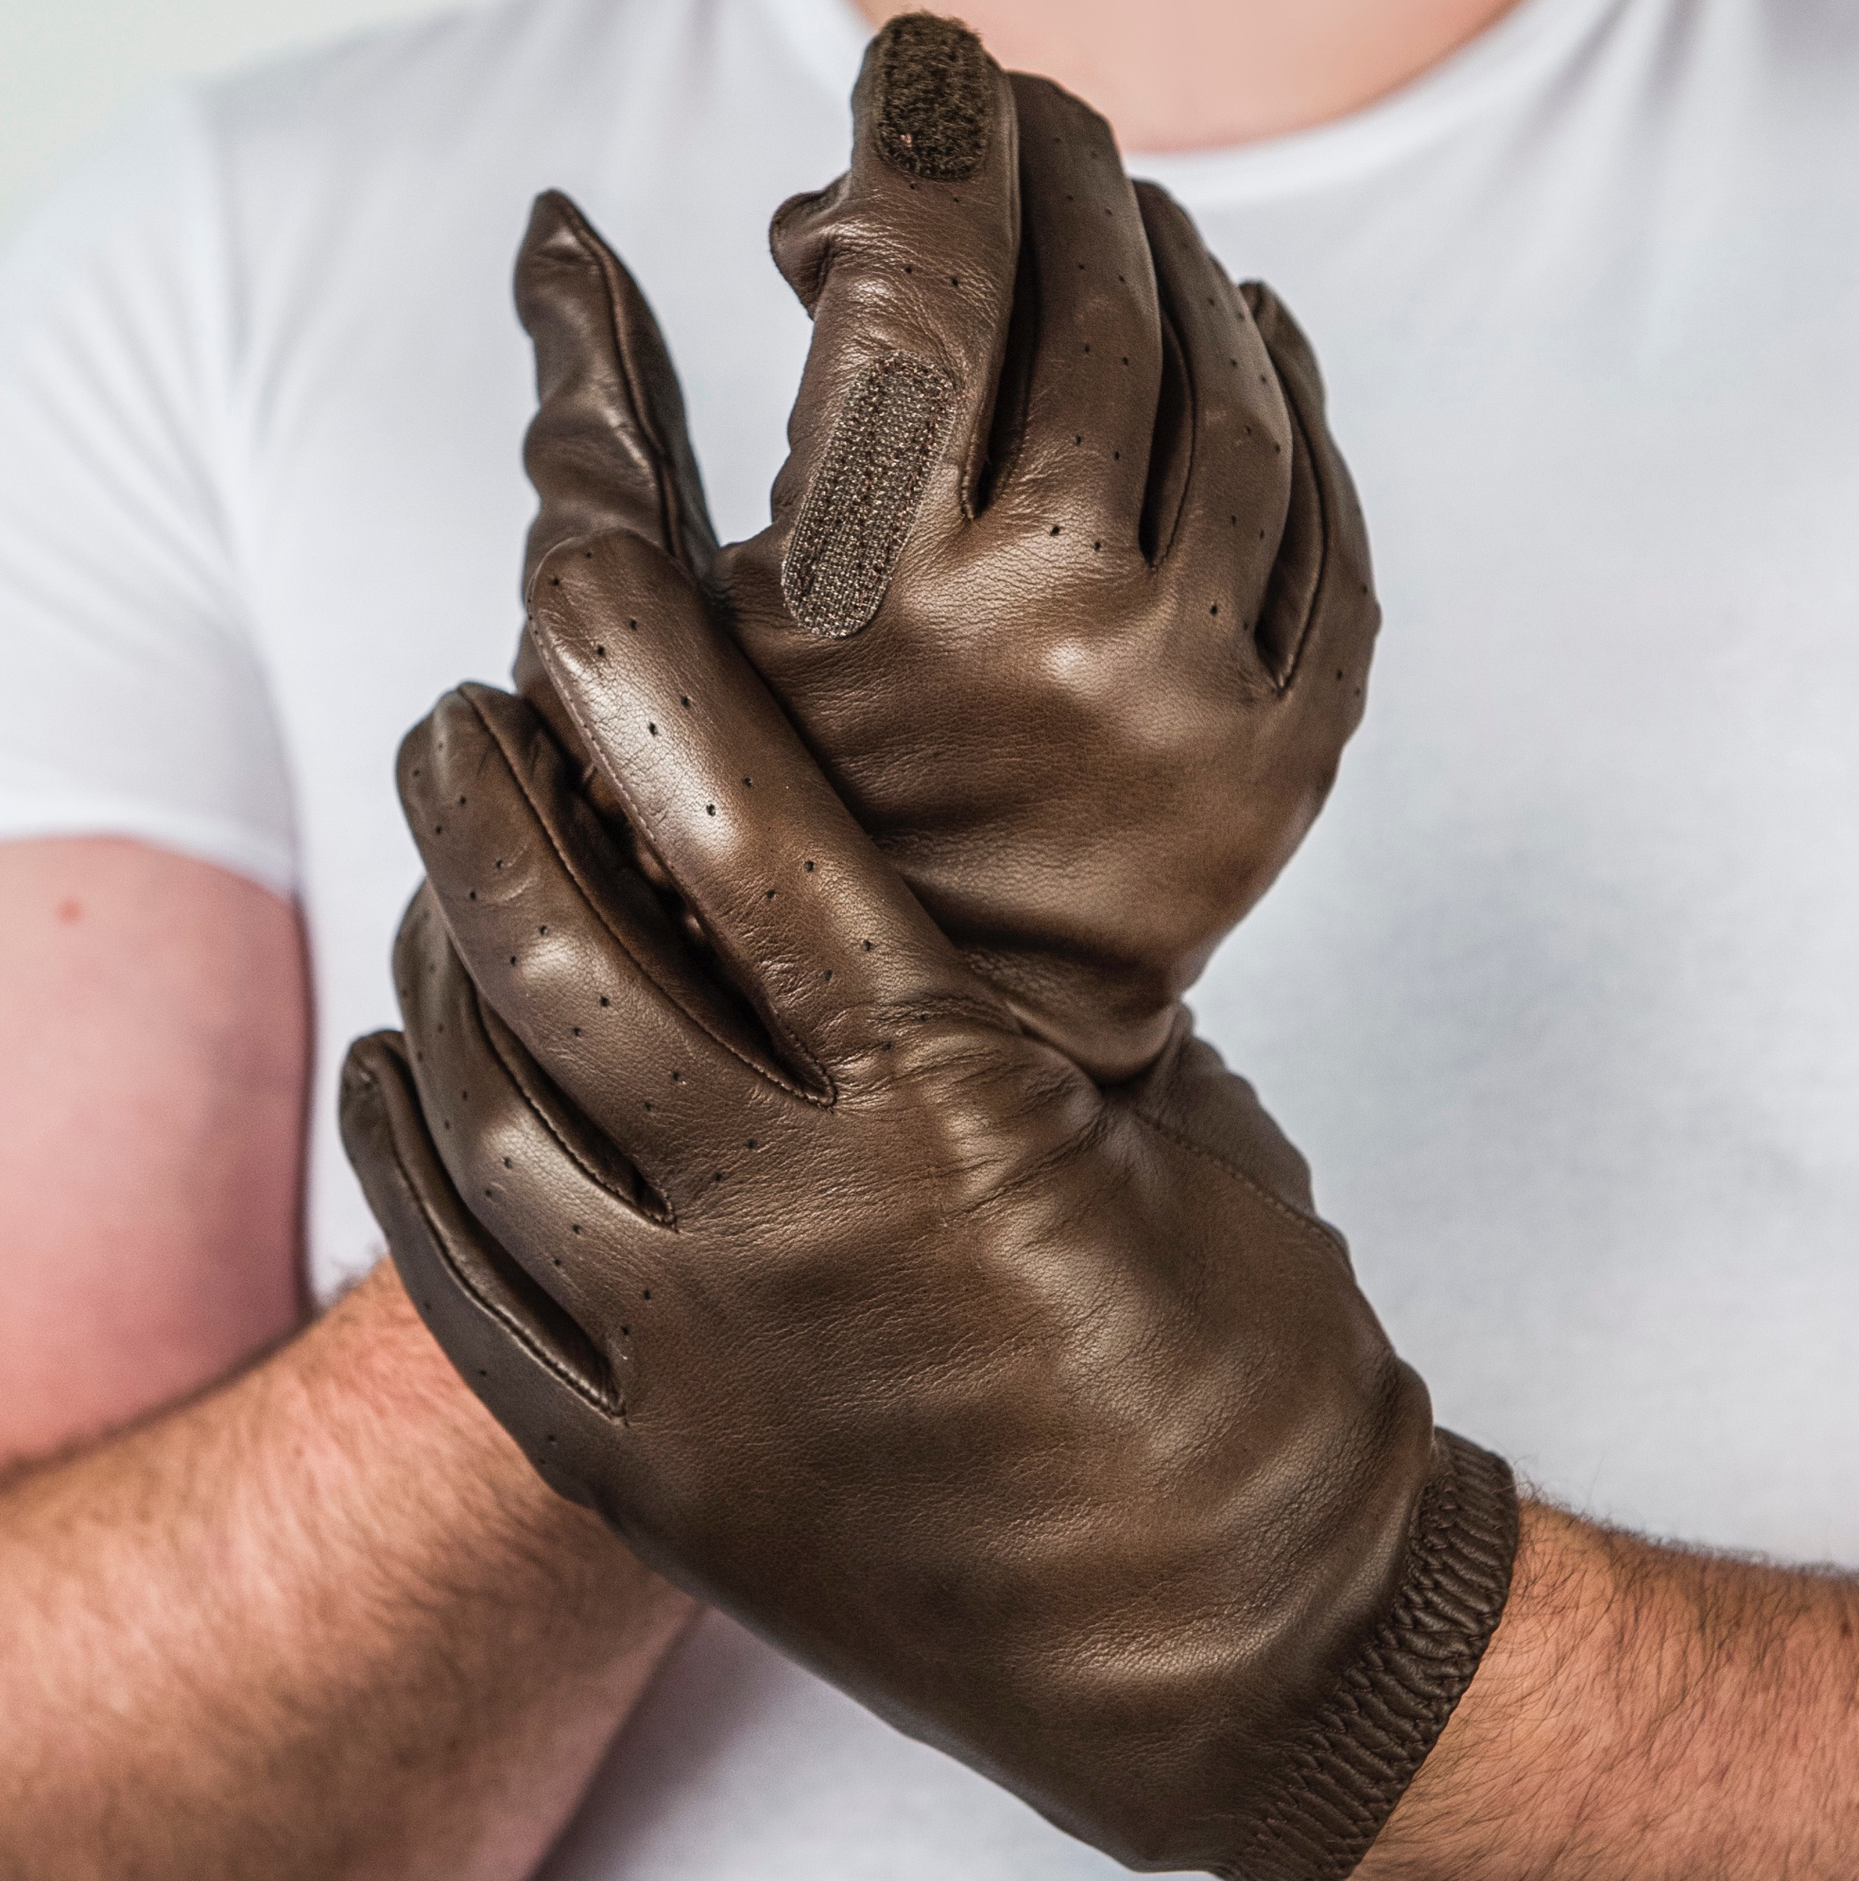
Sporting Collection 2019
The Roan
The Dapple
The Bay
The Palomino
The Putter
The Roan
Product Code: 040
Standard size: £41.35
RRP: £75.00
The Dapple
Product Code: 041
Standard size: £60.22
RRP: £115.00
The Bay
Product Code: 042
Standard size: £49.30
RRP: £95.00
The Palomino
Product Code: 043
Standard size: £51.78
RRP: £100.00
The Putter
Product Code: 053
Standard size: £51.18
RRP: £95.00
The Mallard
The Capercailly
The Ptarmigan
The Mallard
Product Code: 048
Standard size: £82.64
RRP: £150.00
The Capercailly
Product Code: 047
Standard size: £53.27
RRP: £115.00
The Ptarmigan
Product Code: 046
Standard size: £58.26
RRP: £110.00
Minimum order: Standard - 5 pairs of gloves
Bespoke -1 pair of gloves
Bespoke pattern charge: £4.00 per pair of gloves

