Slide 1
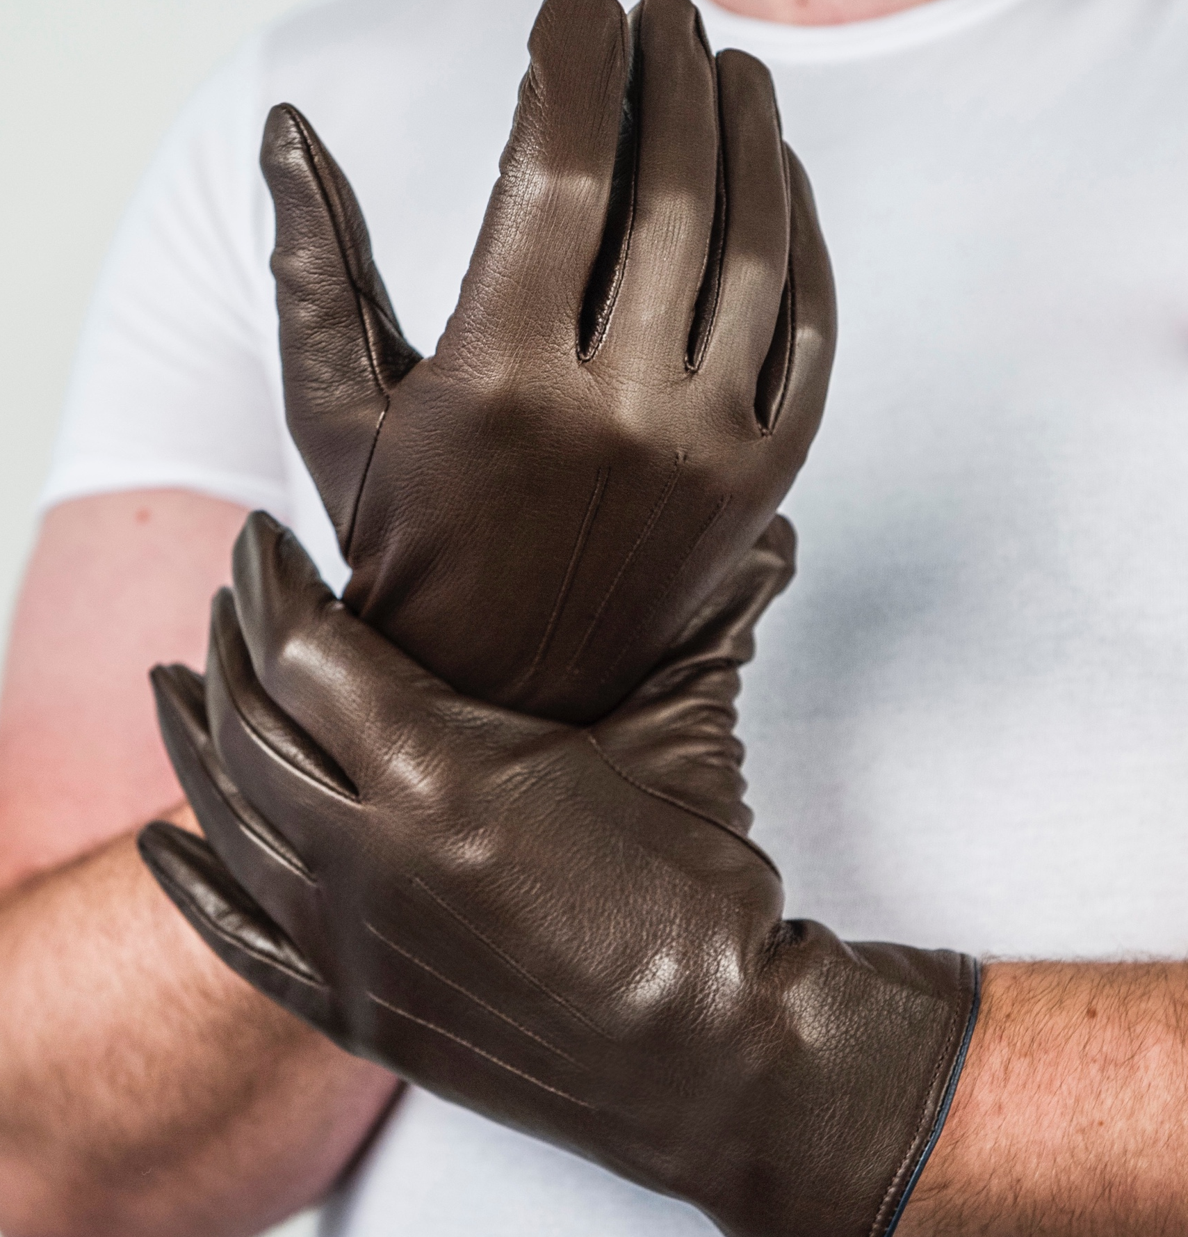
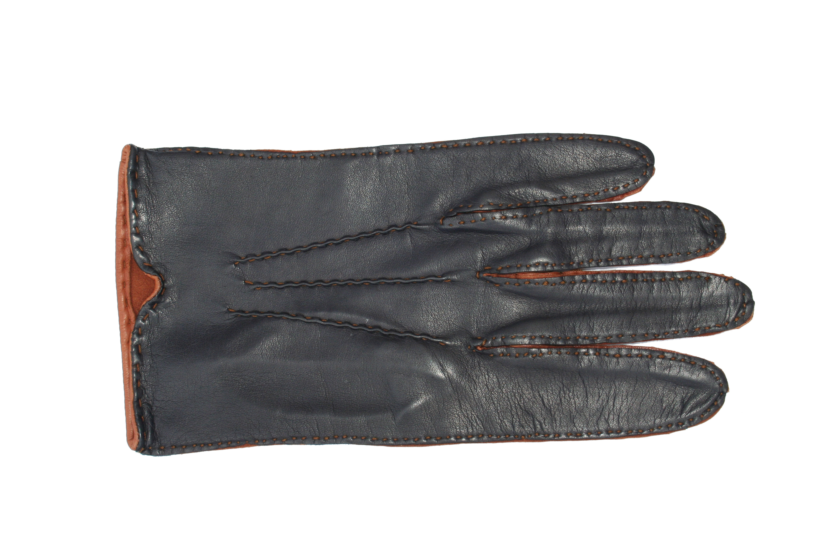
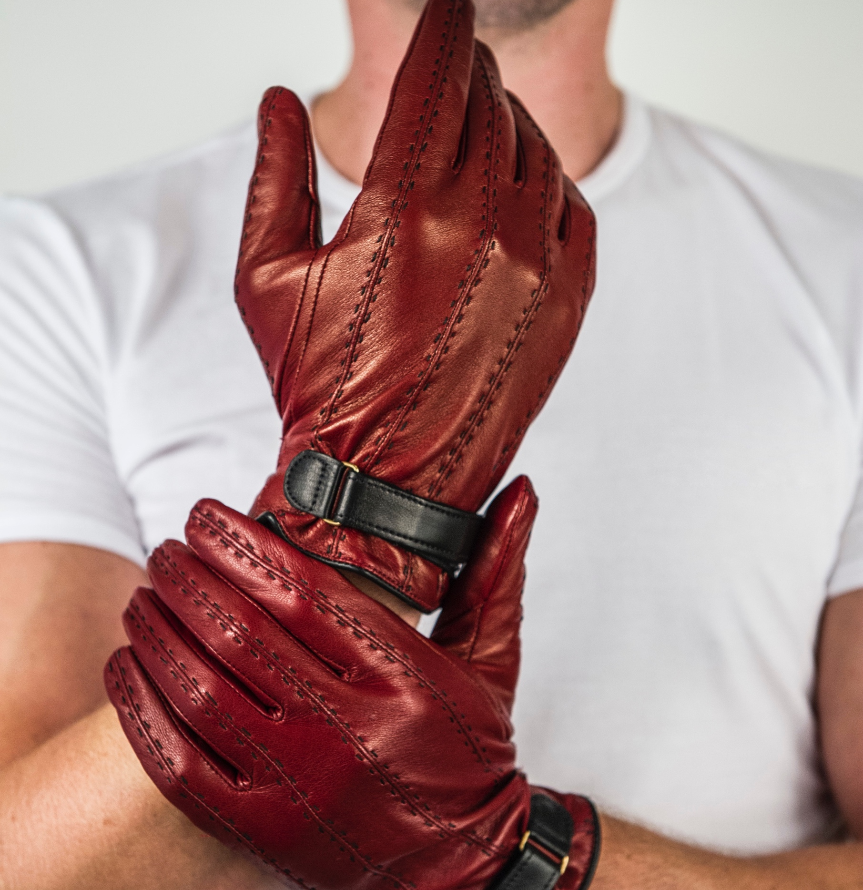
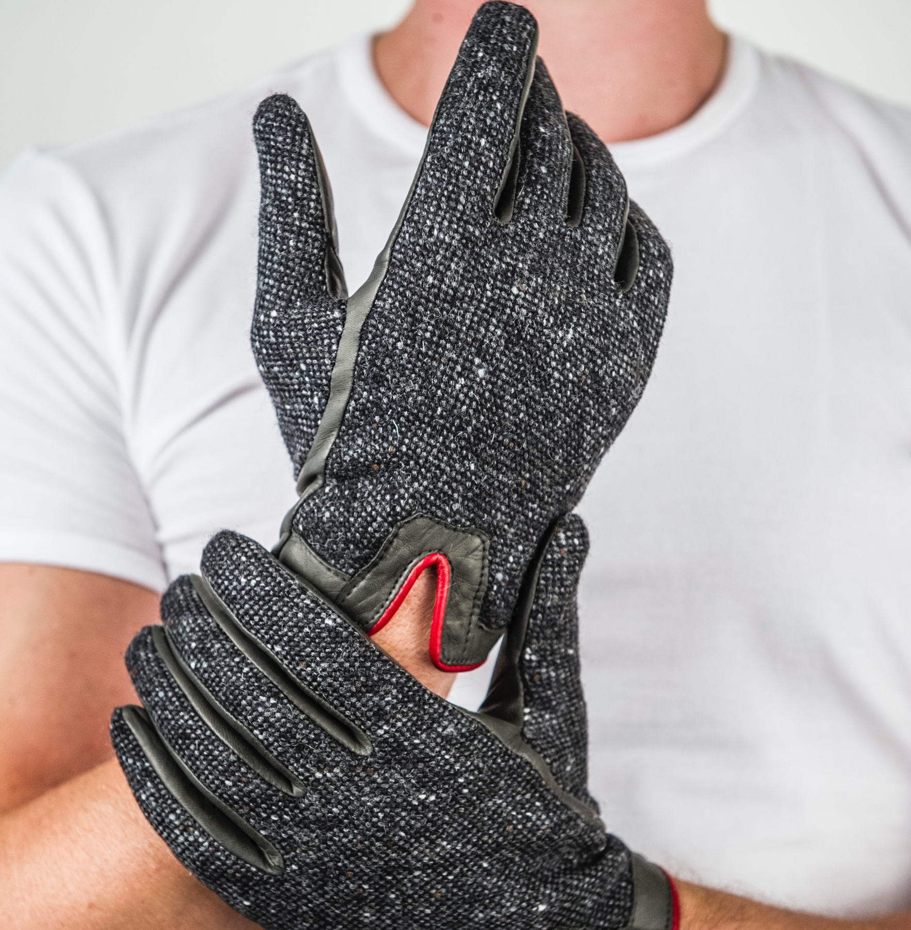
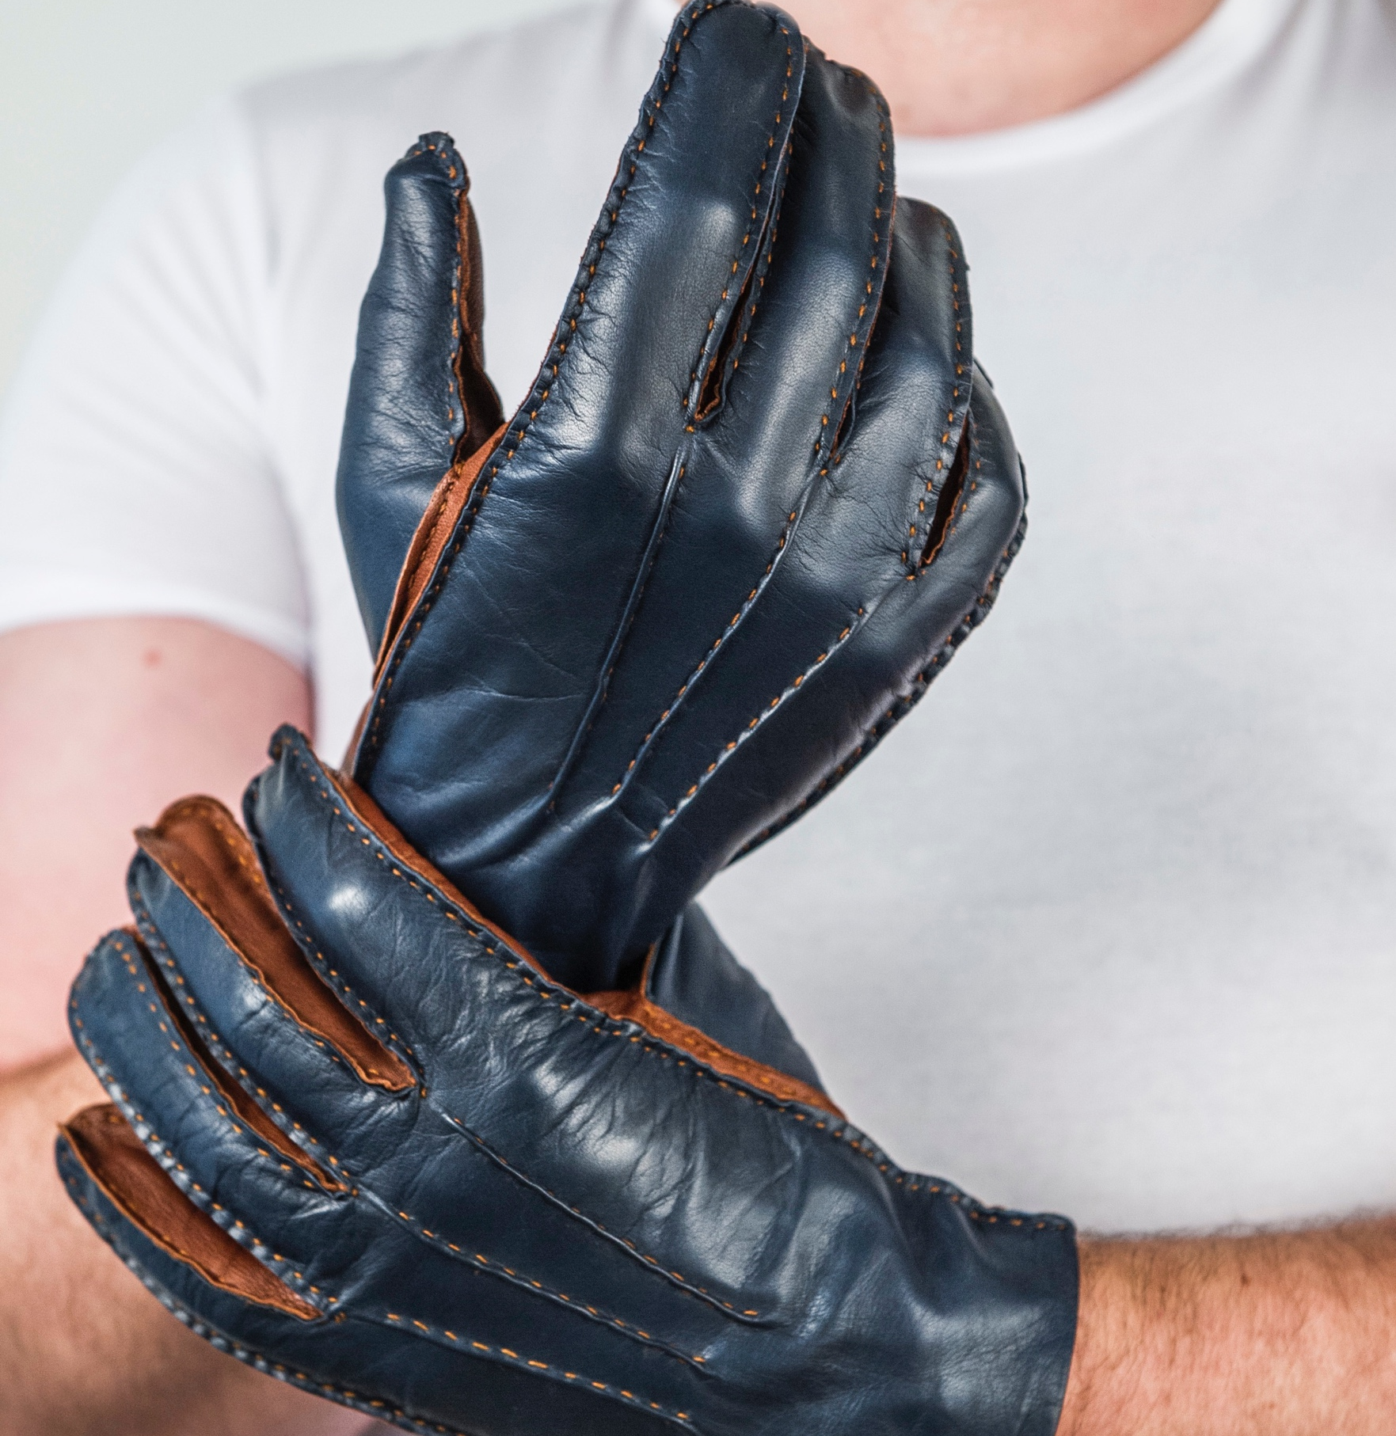
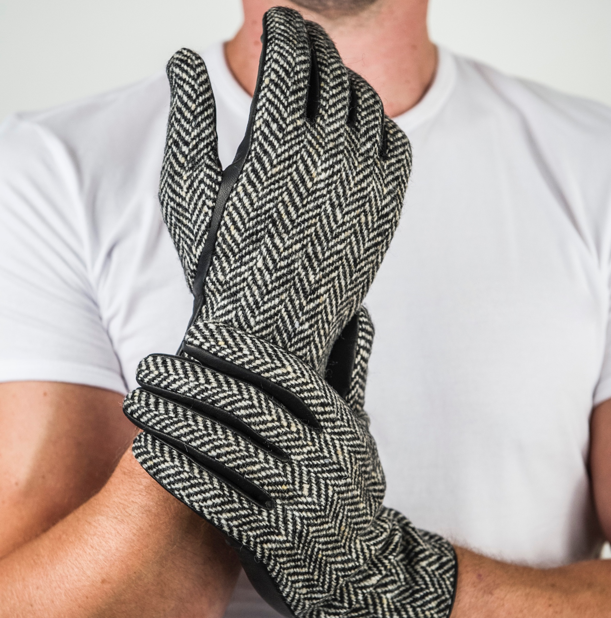
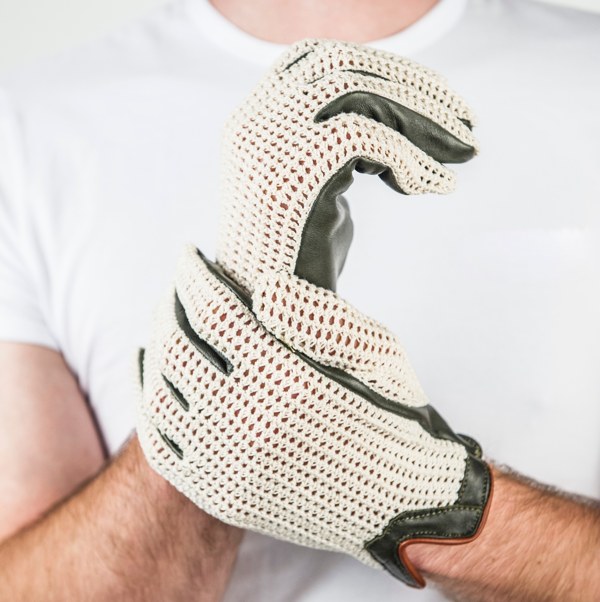
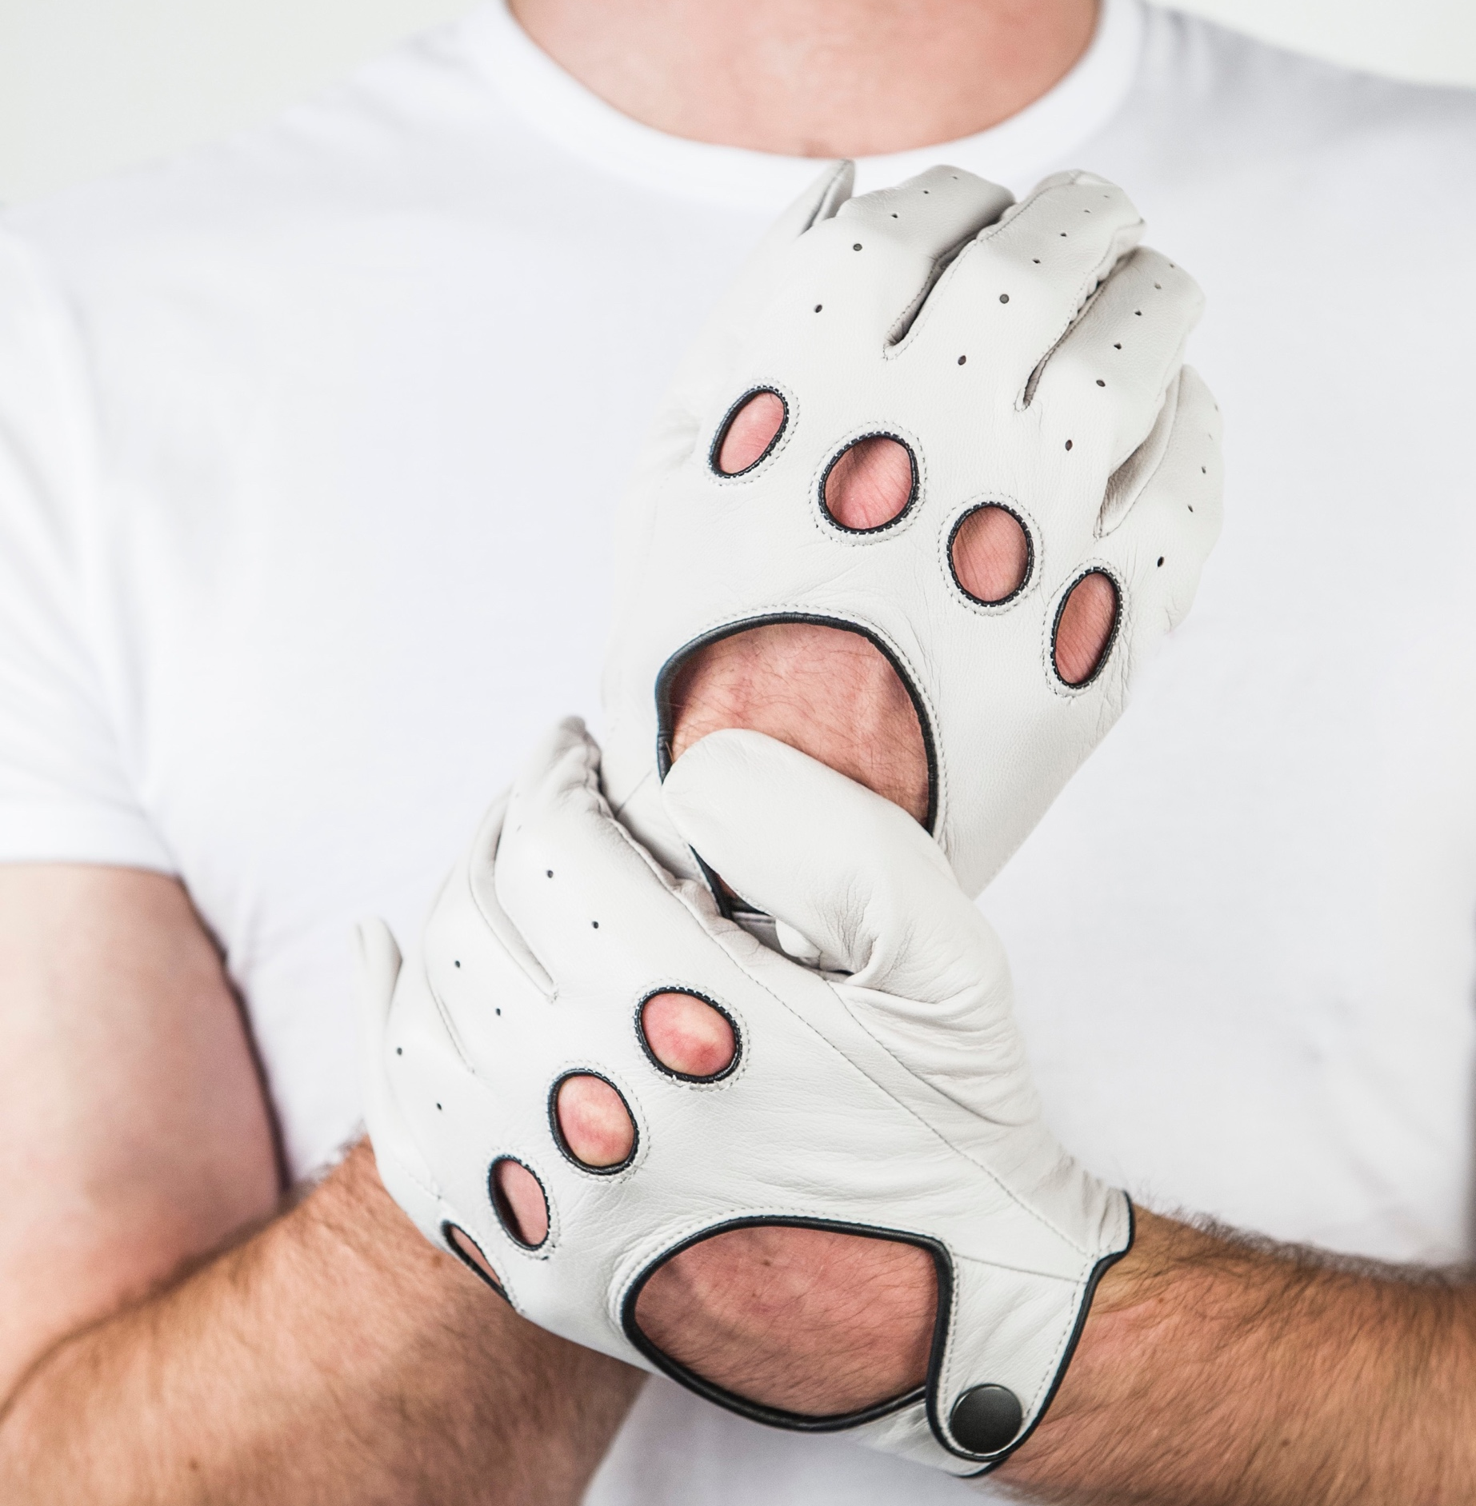
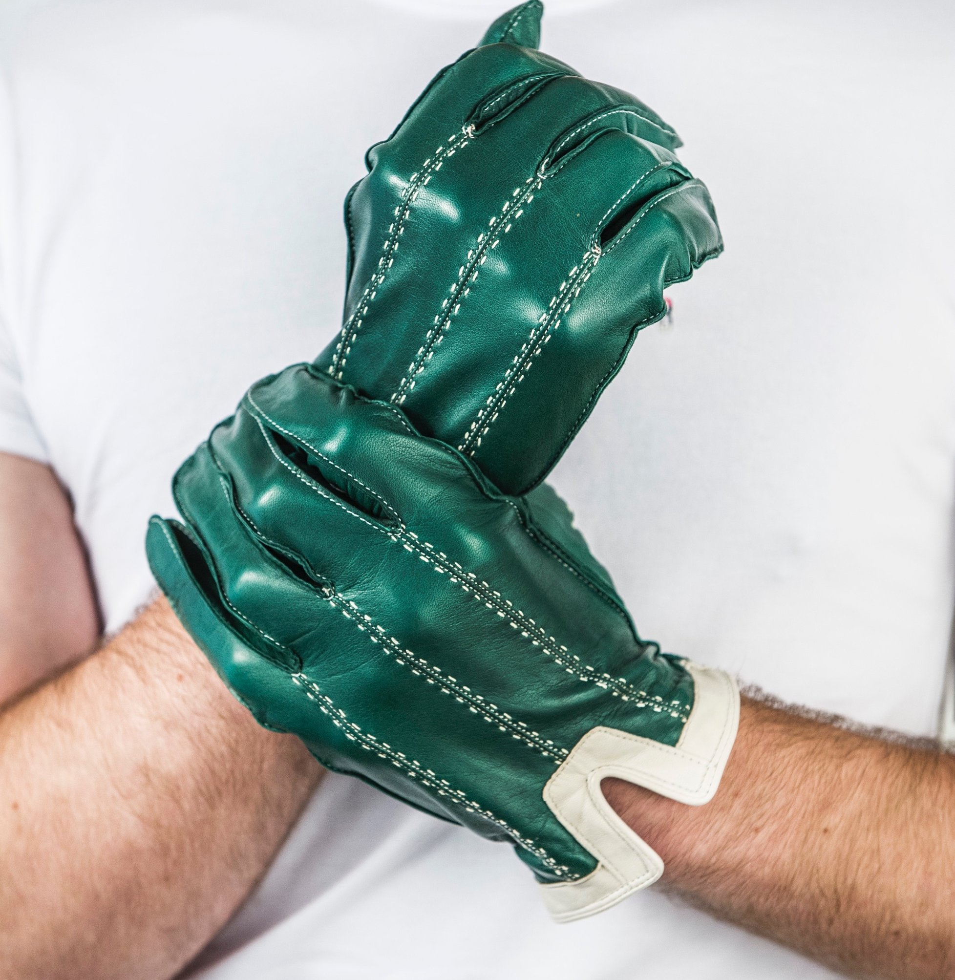
Men's Collection 2019
The Cary
The Humphrey
The Errol
The Cary Tweed
The Monte Carlo Tweed
The Cary
Product Code: 000
Standard size: £53.27
RRP: £115.00
The Humphrey
Product Code: 002
Standard size: £72.68
RRP: £135.00
The Errol
Product Code: 003
Standard size: £95.08
RRP: £175.00
The Cary Tweed
Product Code: 050
Standard size: £72.26
RRP: £140.00
The Monte Carlo Tweed
Product Code: 051
Standard size: £73.42
RRP: £140.00
The Monte Carlo
The Le Mans
The Brooklands
The Monte Carlo
Product Code: 035
Standard size: £61.74
RRP: £115.00
The Le Mans
Product Code: 034
Standard size: £83.81
RRP: £155.00
The Brooklands
Product Code: 032
Standard size: £89.12
RRP: £165.00
The Le Mans
The Brooklands
Minimum order: Standard - 5 pairs of gloves
Bespoke -1 pair of gloves
Bespoke pattern charge: £4.00 per pair of gloves

