Slide 1
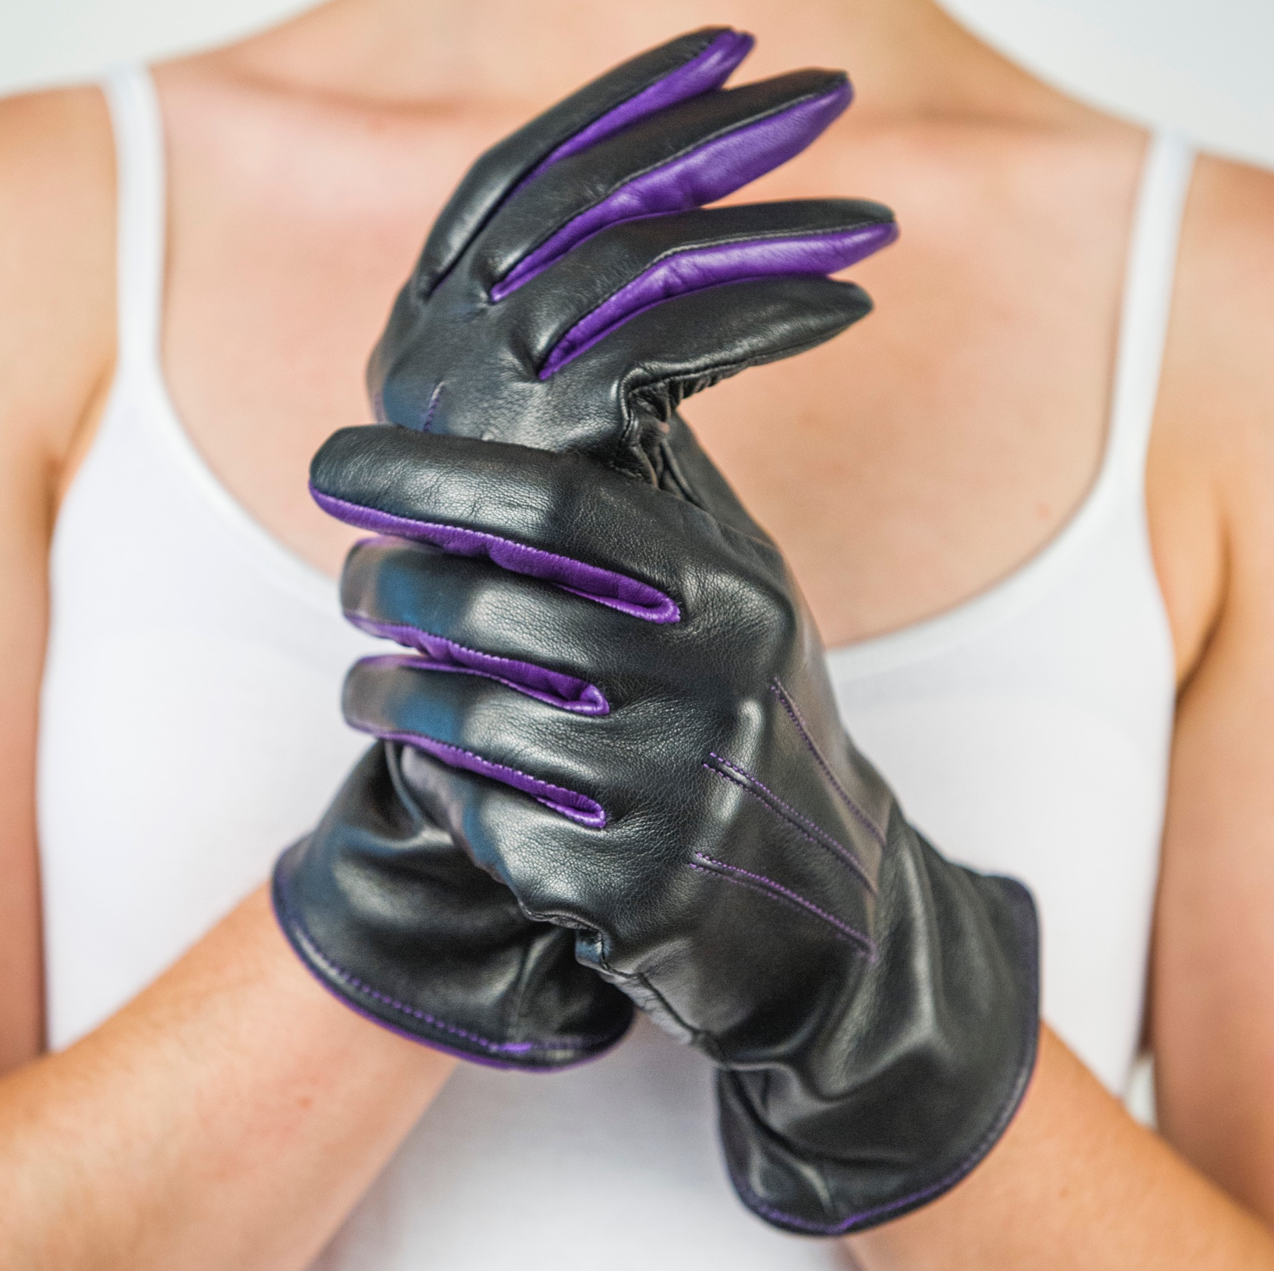
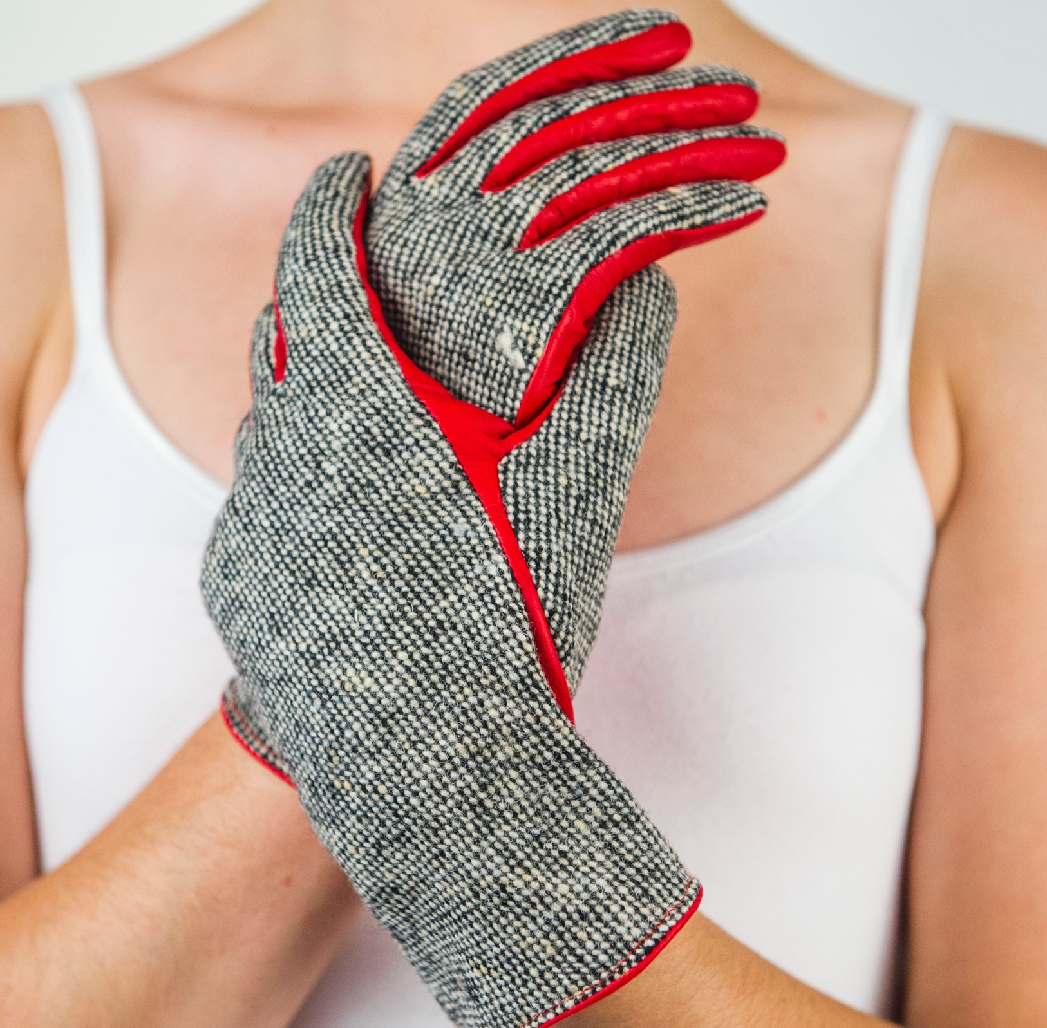
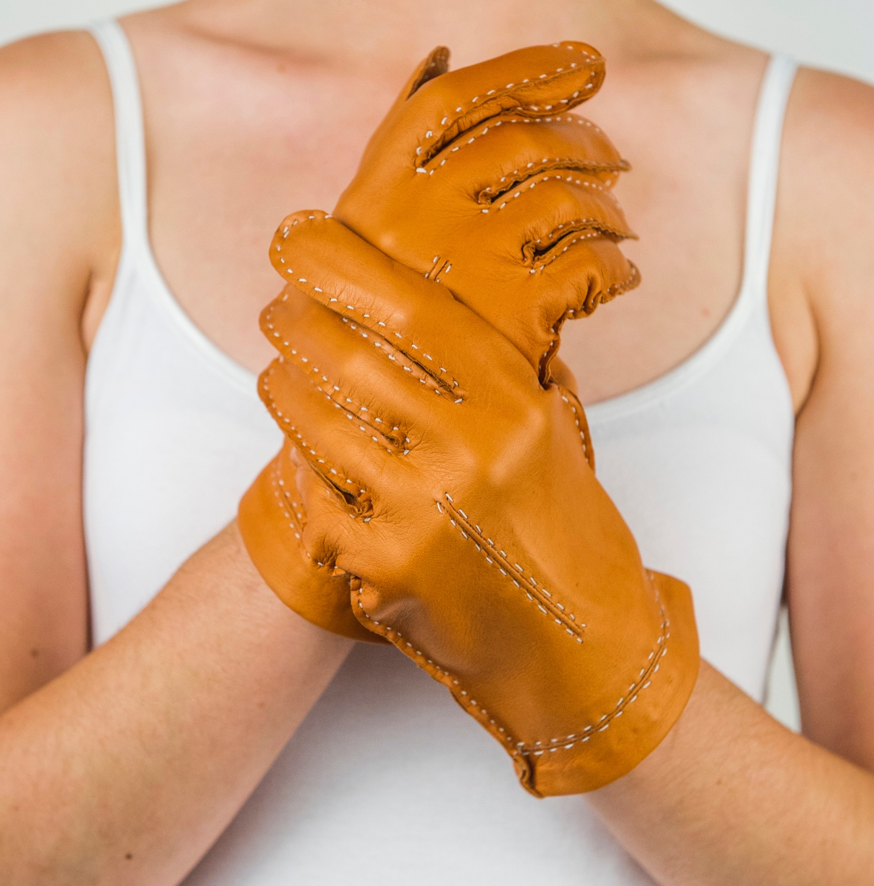
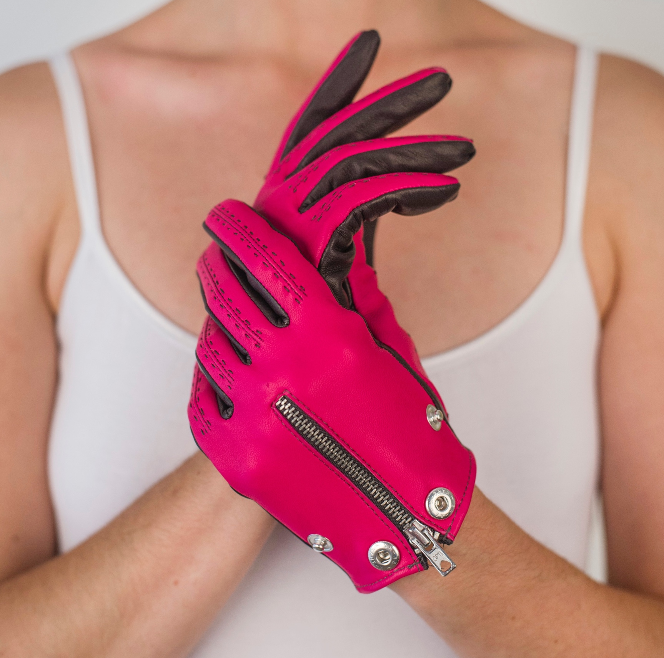
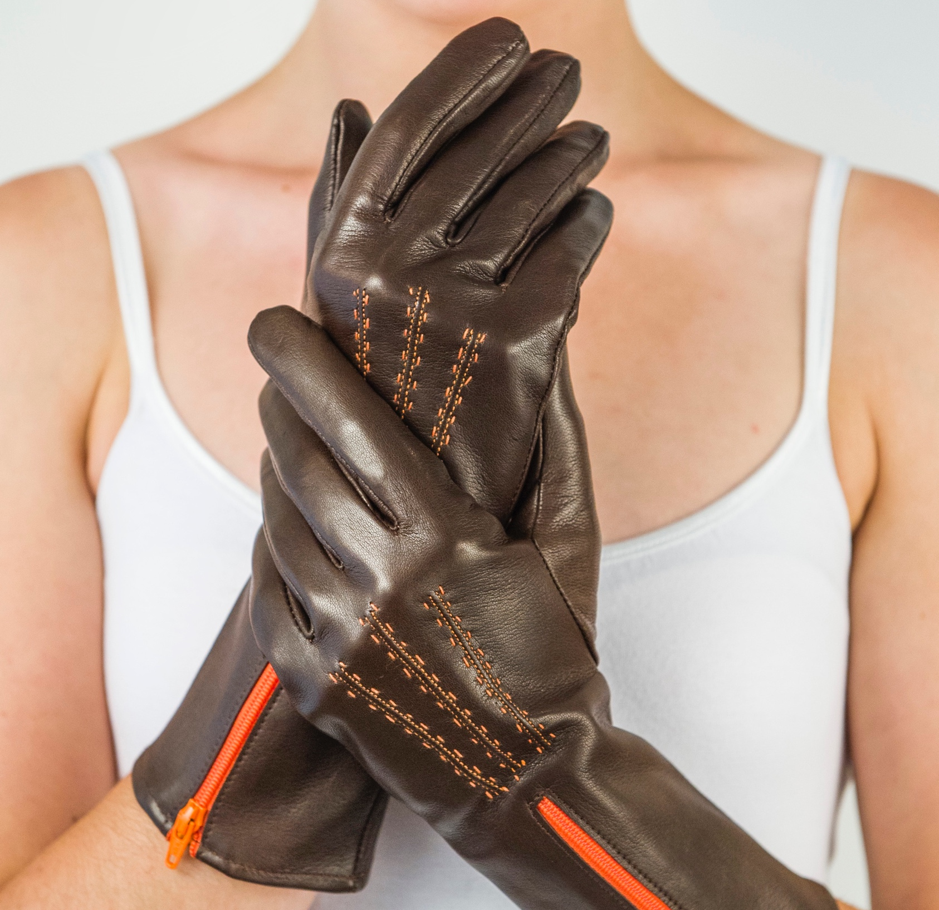
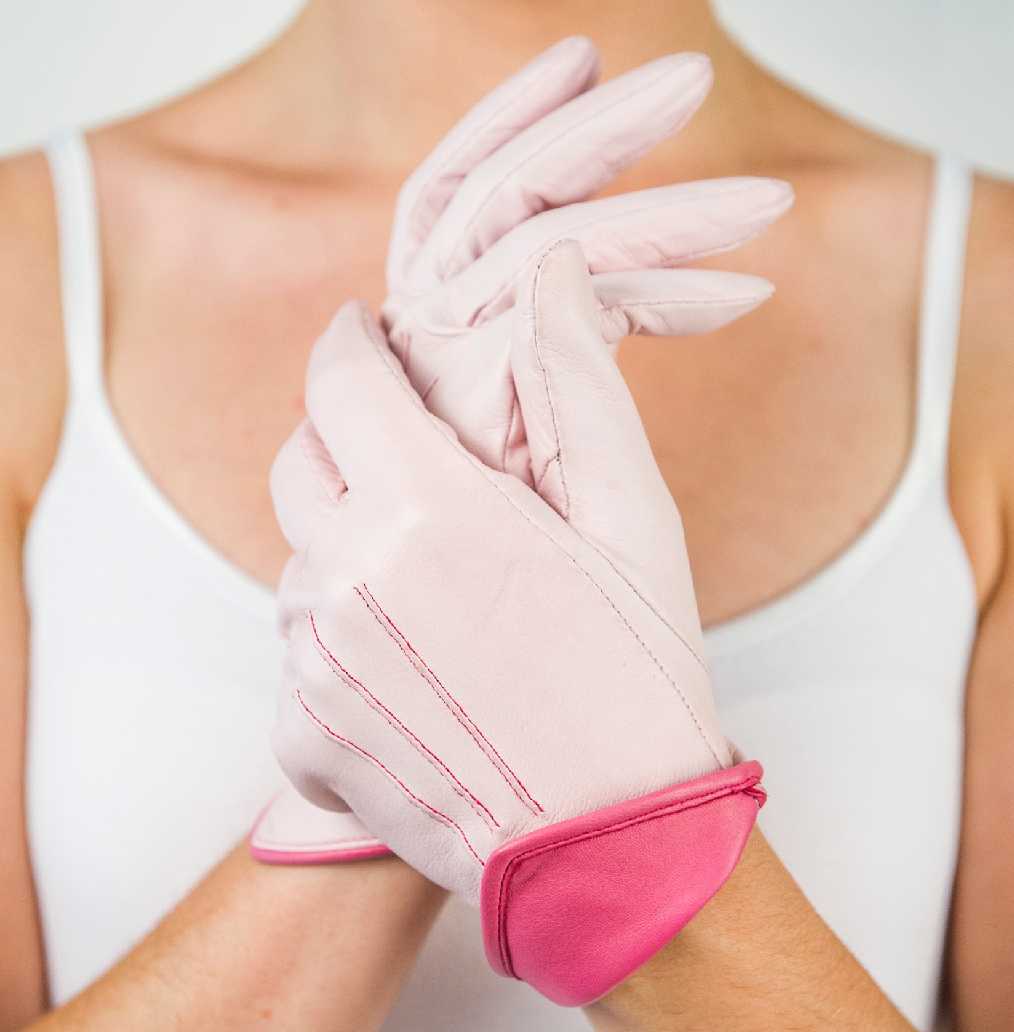
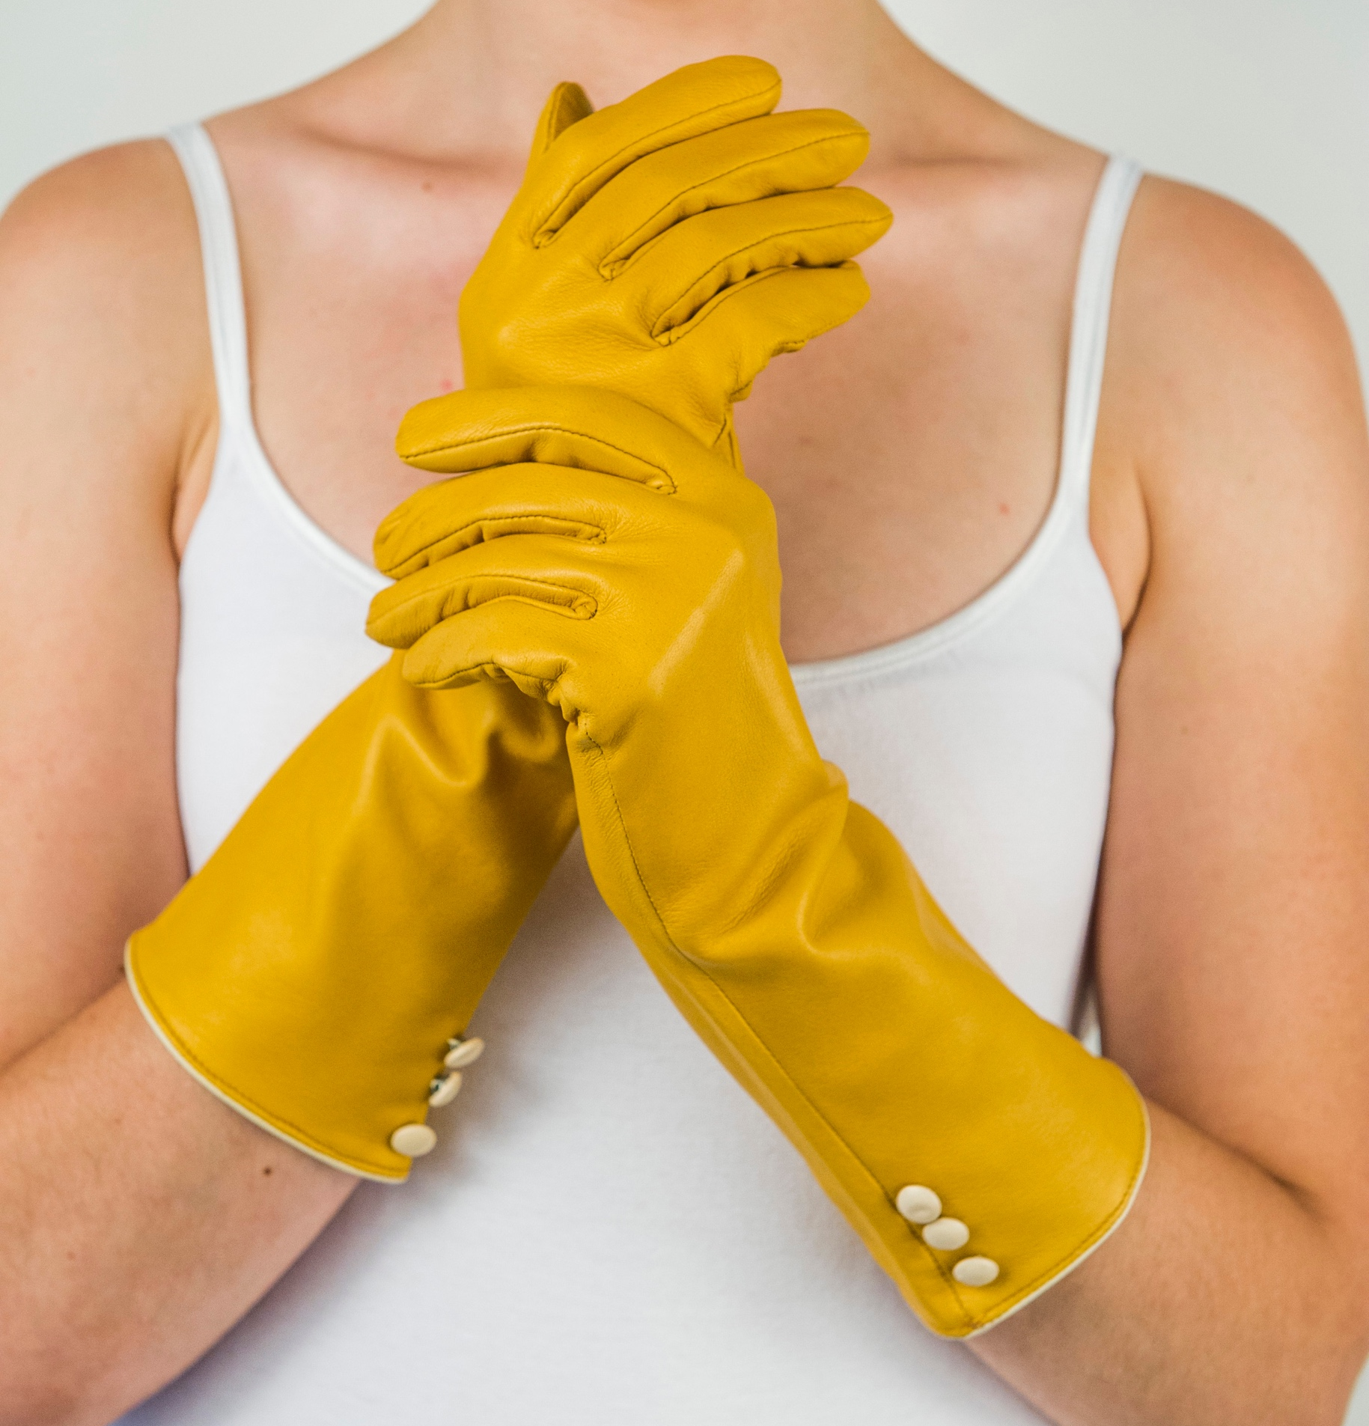
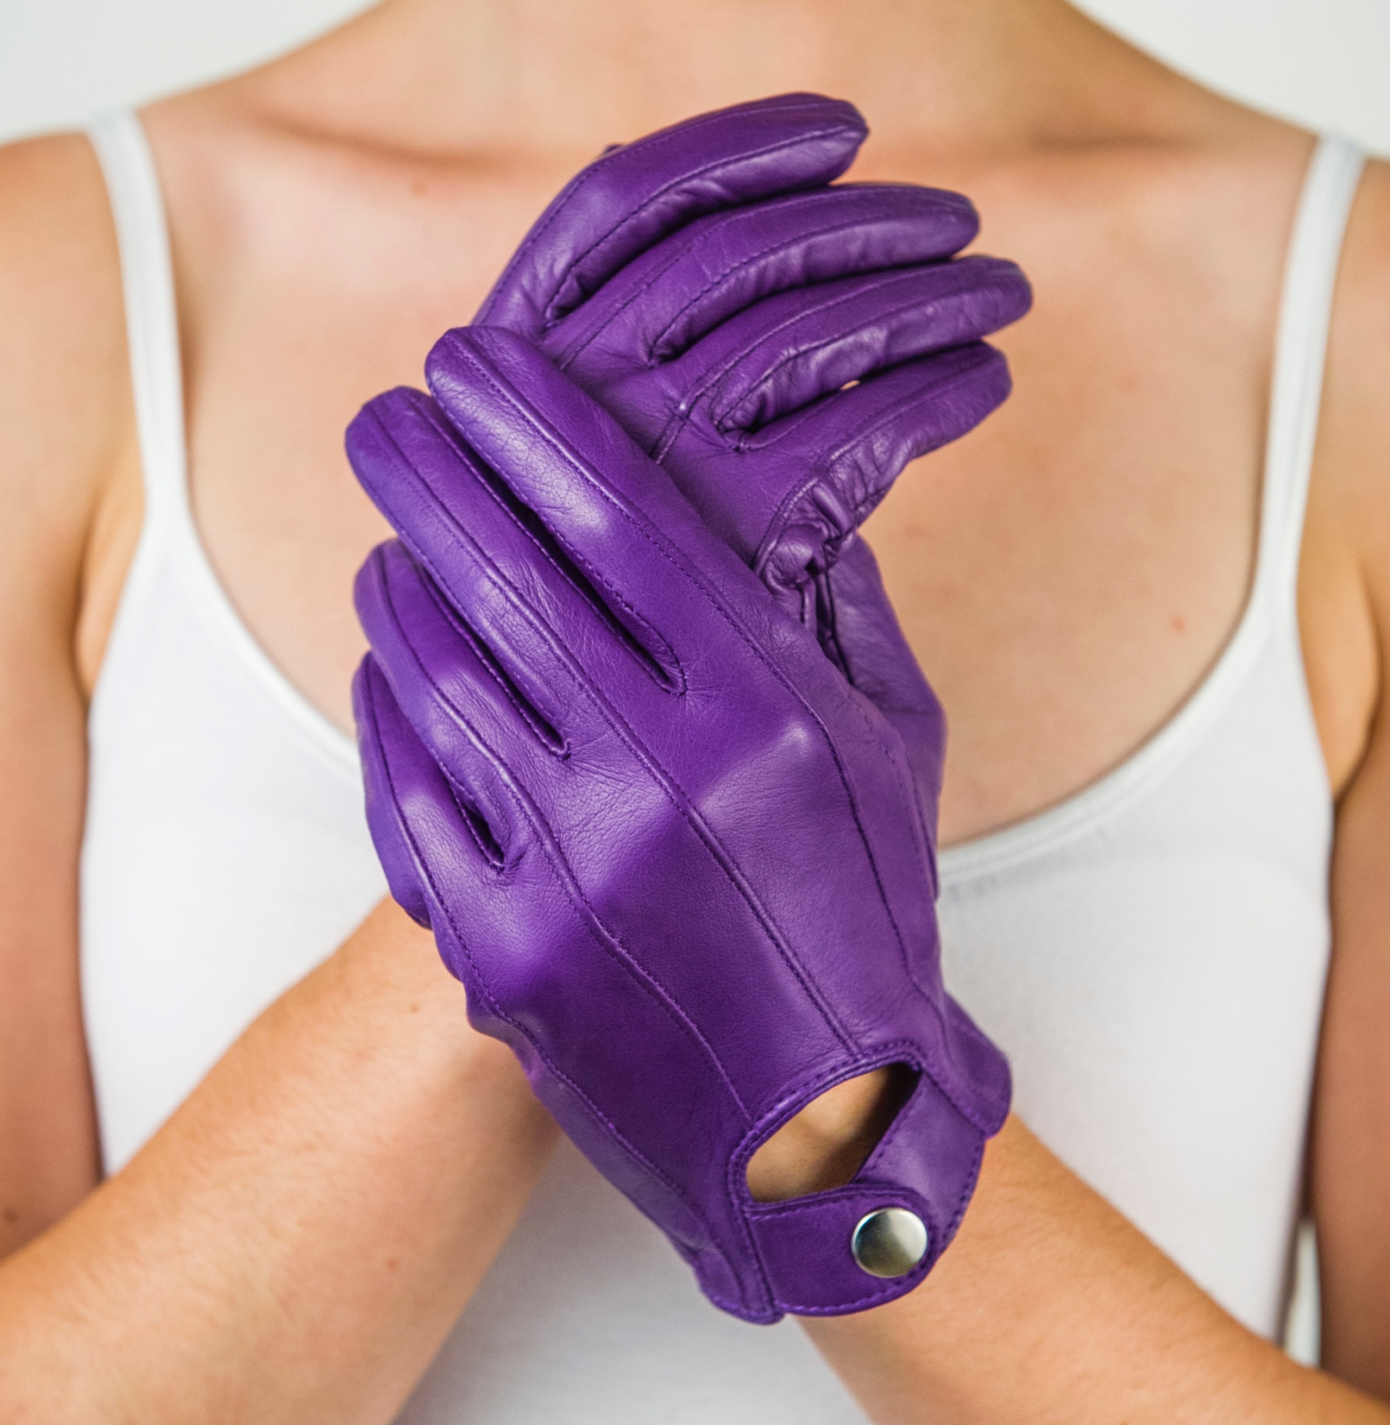
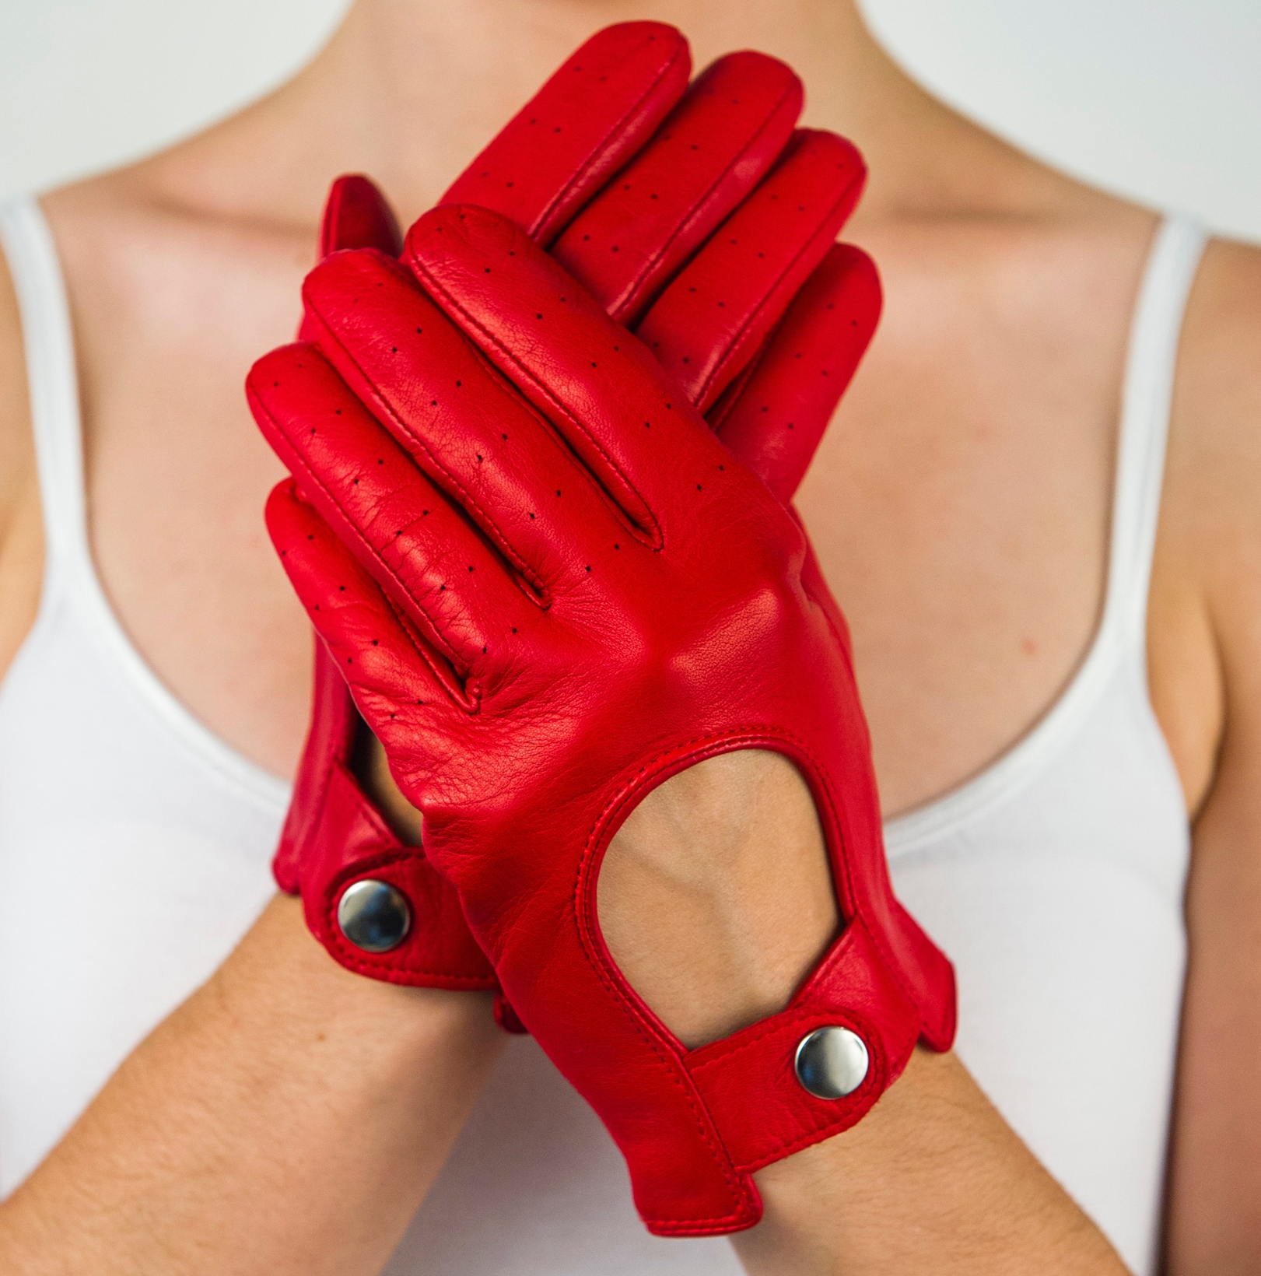
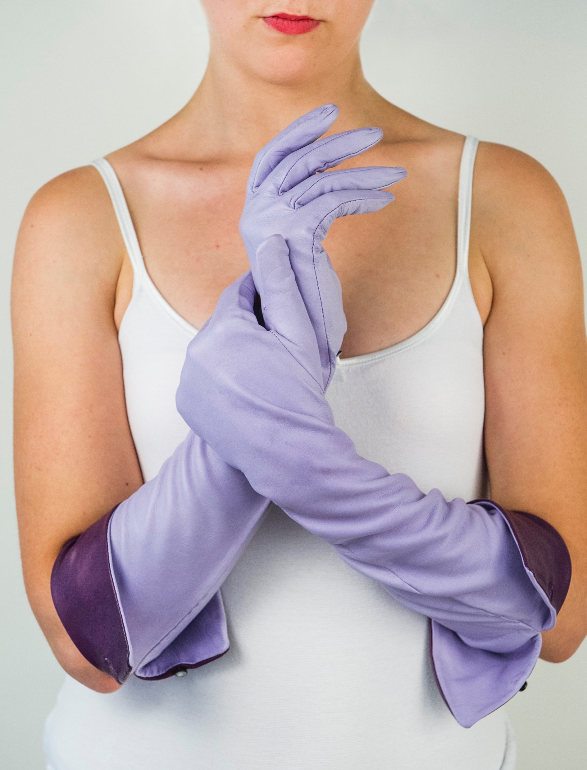
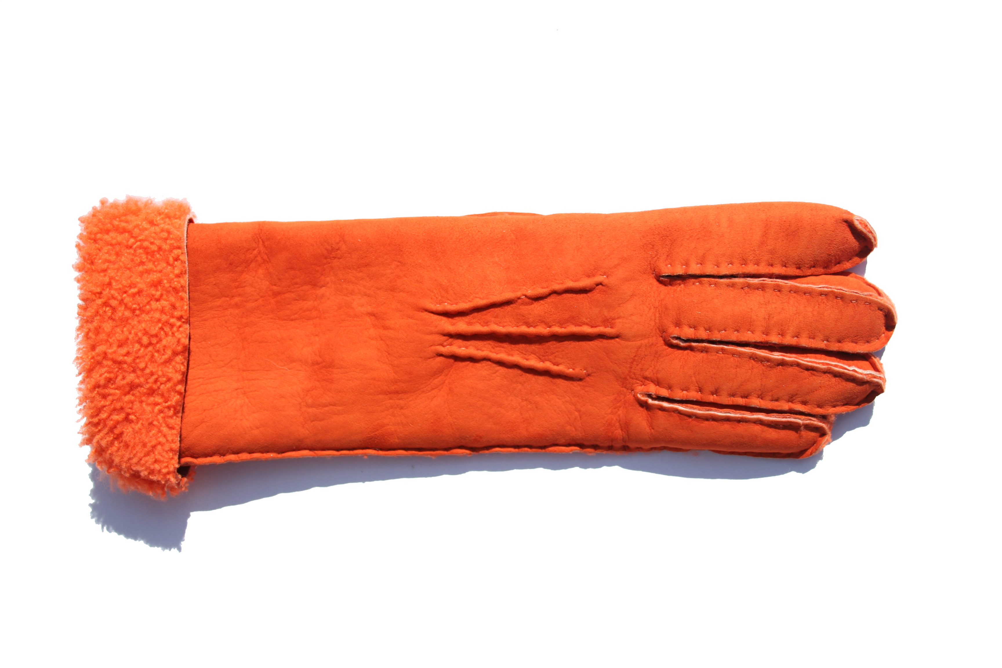
Women’s Collection 2017
The Sophia
The Sophia Tweed
The Marlene
The Gisele
The Naomi
The Sophia
Product Code: 010
Standard size: £49.75
RRP: £115.00
The Sophia Tweed
Product Code: 049
Standard size: £67.16
RRP: £140.00
The Marlene
Product Code: 015
Standard size: £77.13
RRP: £155.00
The Gisele
Product Code: 036
Standard size: £74.40
RRP: £150.00
The Naomi
Product Code: 037
Standard size: £75.31
RRP: £150.00
The Grace
The Raquel
The Heidi
The Cindy
The Ginger
The Grace
Product Code: 013
Standard size: £76.21
RRP: £155.00
The Raquel
Product Code: 017
Standard size: £75.76
RRP: £155.00
The Heidi
Product Code: 038
Standard size: £66.18
RRP: £130.00
The Cindy
Product Code: 039
Standard size: £64.35
RRP: £130.00
The Ginger
Product Code: 018
Standard size: £114.09
RRP: £230.00
Minimum order: Standard - 5 pairs of gloves
Bespoke -1 pair of gloves
Bespoke pattern charge: £3.50 per pair of gloves

Slide 2
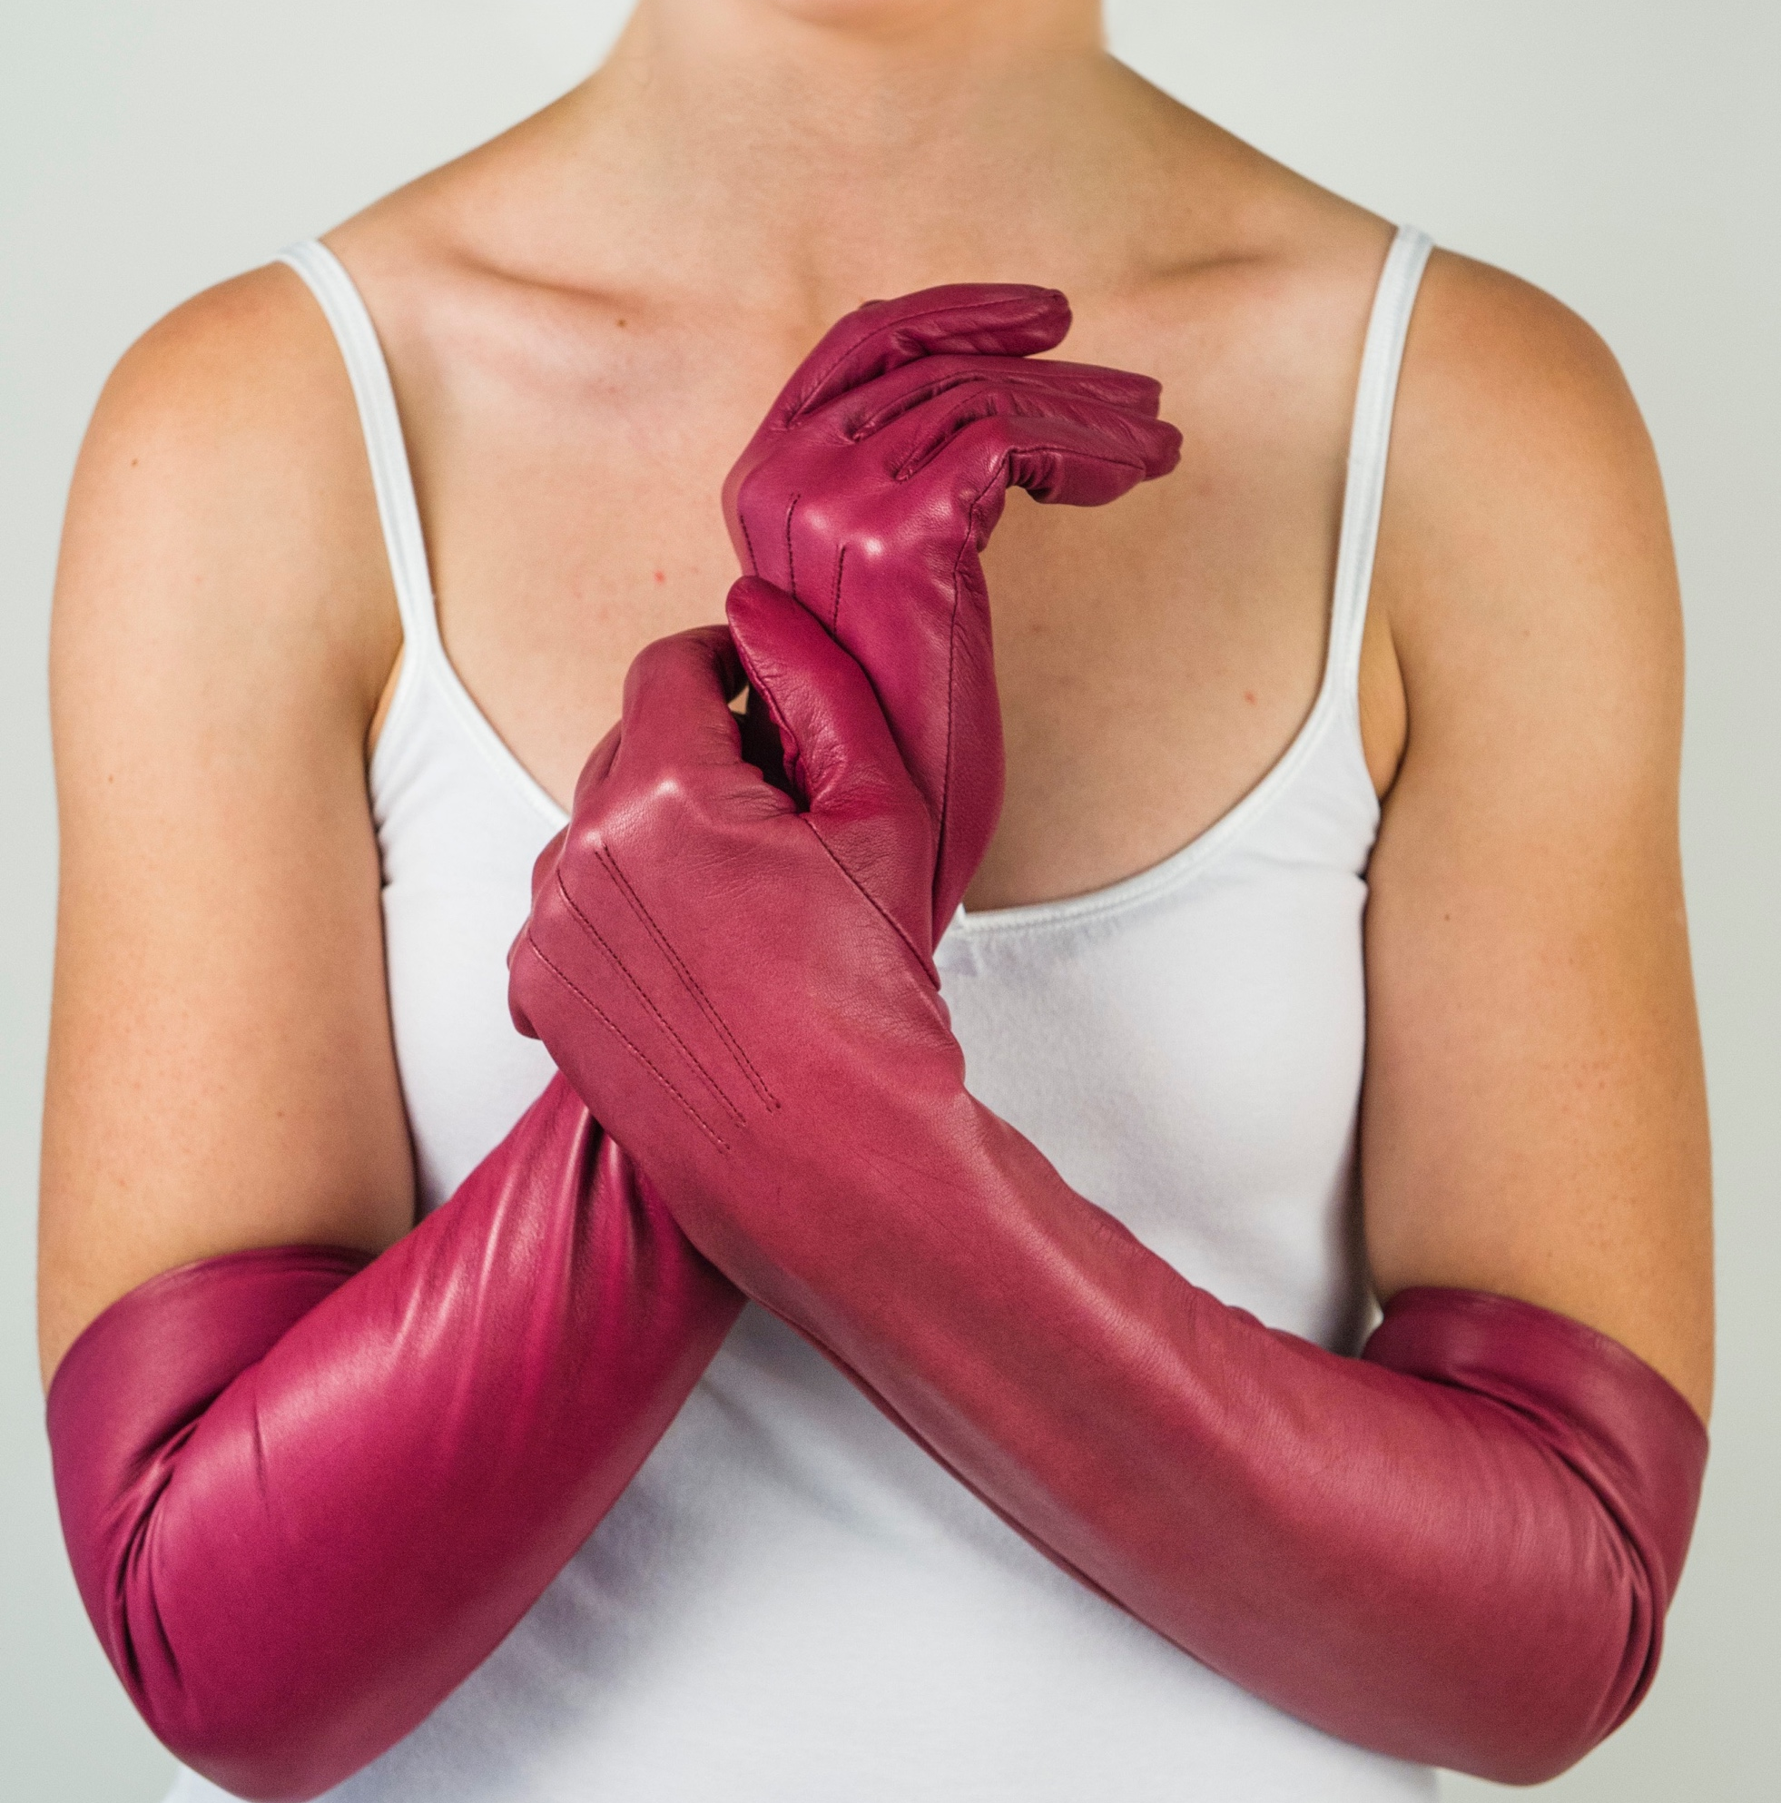
Women’s Collection 2017
The Darcy
The Darcy
Product Code: 052
Standard size: £102.68
RRP: £205.00
Minimum order: Standard - 5 pairs of gloves
Bespoke -1 pair of gloves
Bespoke pattern charge: £3.50 per pair of gloves

